Slide 1



Hadron Spectroscopy from Belle to EIC
Kiyoshi Tanida <kytanida@gmail.com>
(Japan Atomic Energy Agency)
@研究会「EICで展開する新たな
原子核・素粒子物理」
30 May 2024

Slide 2
Introduction
Hadron spectroscopy
  Study hadron resonances and reveal the nature
Ground states and low-lying states can be understood by quark-model rather well
  Classification, mass, magnetic moments, …
  Exception: high-energy reactions (e.g., DIS)
Exotic hadrons
  Hadrons NOT well described (classified)
  by conventional quark model
  Many candidates found; very hot field in hadron spectroscopy

Slide 3
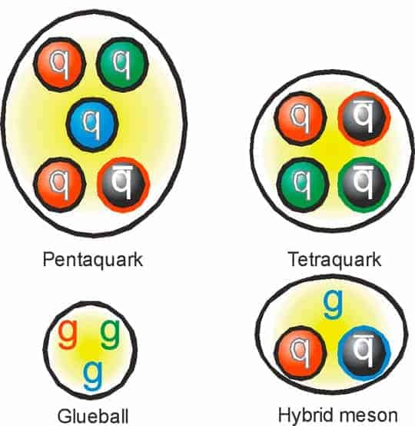
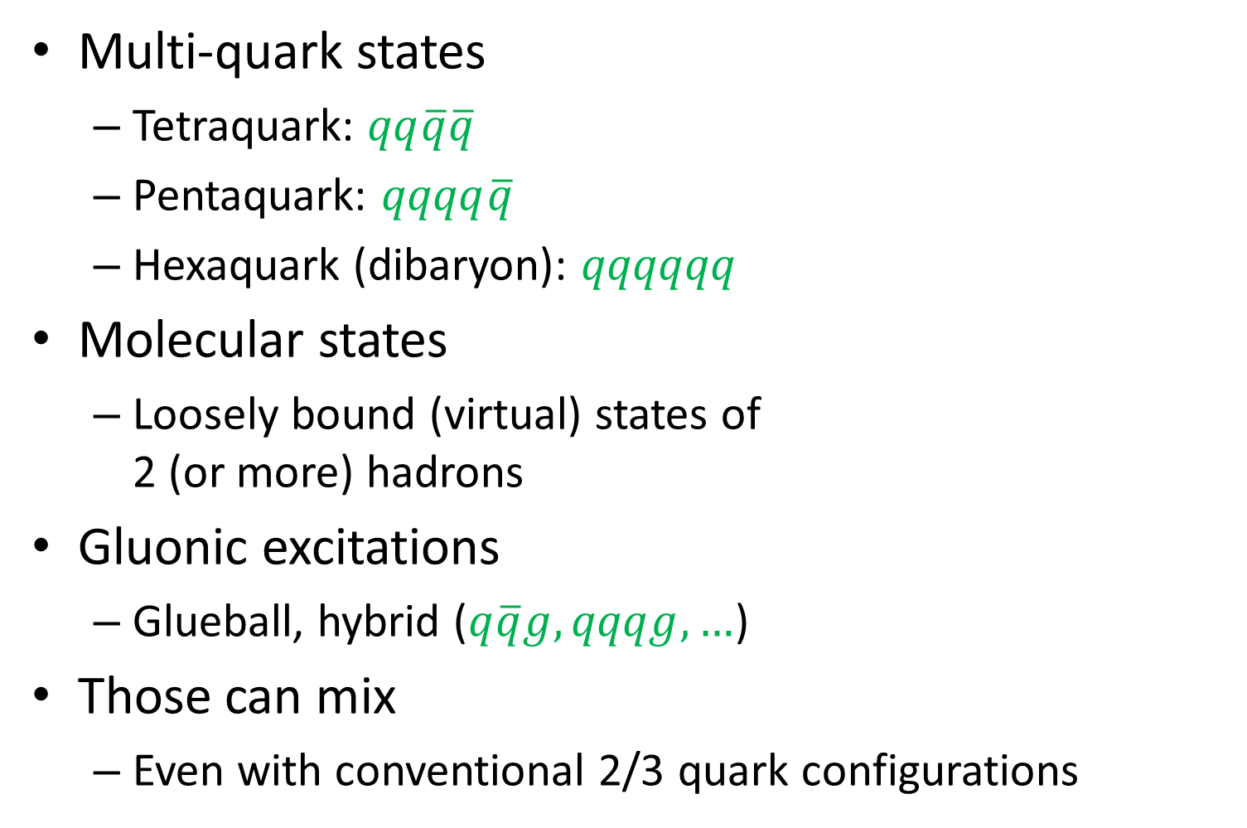
Types of exotic hadrons
Multi-quark states
  Tetraquark: $qq\overline{q}\overline{q}$
  Pentaquark: $qqqq\overline{q}$
  Hexaquark (dibaryon): $qqqqqq$
Molecular states
  Loosely bound (virtual) states of
  2 (or more) hadrons
Gluonic excitations
  Glueball, hybrid ($q\overline{q}g, qqqg, …$)
Those can mix
  Even with conventional 2/3 quark configurations

Slide 4
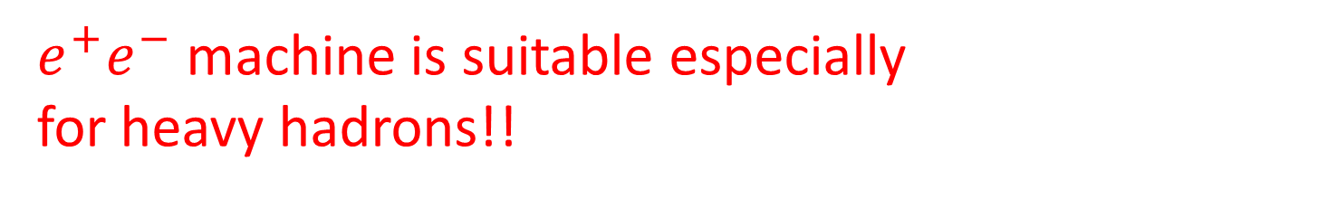
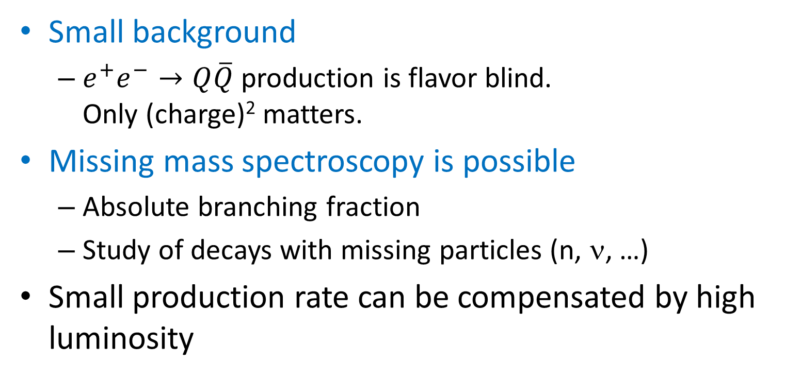
e⁺e⁻ for hadron spectroscopy
Small background
  $e^{+}e^{−}→Q\overline{Q}$ production is flavor blind.
  Only (charge)² matters.
Missing mass spectroscopy is possible
  Absolute branching fraction
  Study of decays with missing particles (n, ν, …)
Small production rate can be compensated by high luminosity
$e^{+}e^{−}$ machine is suitable especially
for heavy hadrons!!

Slide 5
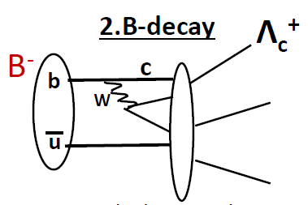

Hadron production in e⁺e⁻
Direct resonance production
  1⁻⁻ states: $ψ, Υ, Y$
  Initial state radiation allows
  lower mass than √s
  2-photon process: 0⁺⁺, 2⁺⁺ ,…
Indirect production
  Quark fragmentation from $Q\overline{Q}$
  Cascade decays
  b → c, $Υ$ decays, …

Slide 6
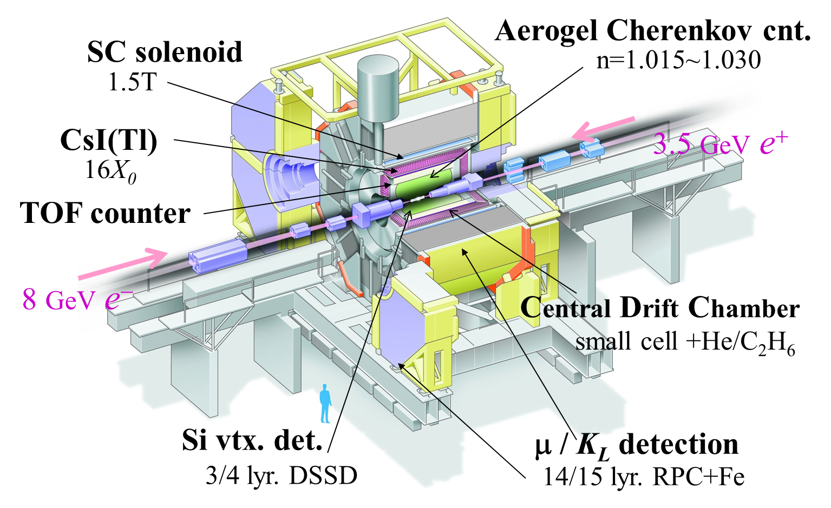
Belle experiment
√s~10.6 GeV
Integrated
Luminosity
~ 1 ab⁻¹
Almost 4π, good momentum resolution (Δp/p～0.1%),
EM calorimeter, PID & Si Vertex detector
Finished in 2010

Slide 7


Huge statistics, good quality
$$Λ_{c}^{+}→pK^{−}π^{+}$$
O(10⁹) $c\overline{c}$ production
O(10⁸) $Λ_{c}^{+}$ production
O(10⁷) $Λ_{c}^{+}→pK^{−}π^{+}$
O(10⁶) reconstructed
Resolution:
< 10 MeV FWHM
S/N ~ 10

Slide 8
(Some of ) Achievements in Belle

Slide 9

X(3872)
First and most famous one
  Very narrow width
  On the $D^{0}{\overline{D}}^{∗0}$ threshold
  Violates isospin in
  J/ψρ vs J/ψω decays
  J^{PC}=1⁺⁺
S-wave $D^{0}{\overline{D}}^{∗0}$molecule
  Threshold effect
  → isospin breaking
  Cusp -- virtual state?
  Mixed with charmonium?
Belle,
PRL91,261801(2003)
X(3872)
→ J/ψπ⁺π⁻
M(J/ψπ⁺π⁻) − M(J/ψ)

Slide 10
Charged states – Z(4430)
Belle, PRD 88 (2013) 074026
Several other candidates.
Some may not be resonances
but cusp or other dynamical enhancements
Z(4430)

Slide 11
Charged states -- Z_{b}
Belle, PRL108,122001(2012)
Molecular states?

Slide 12
Ξ_{c}(2970) – spin-parity
[PRD103, L111101]
PRD94, 052011 (2016)
Spin ½: from angular correlation of
Ξ_{c}(2970) → Ξ_{c}*(2645)π₁ → Ξ_{c}π₁π₂
Parity +: obtained from BR of Ξ_{c}(2970) → Ξ_{c}*/Ξ_{c}’
Hint for Roper (N(1440))? Same J^{P} & E_{x}

Slide 13
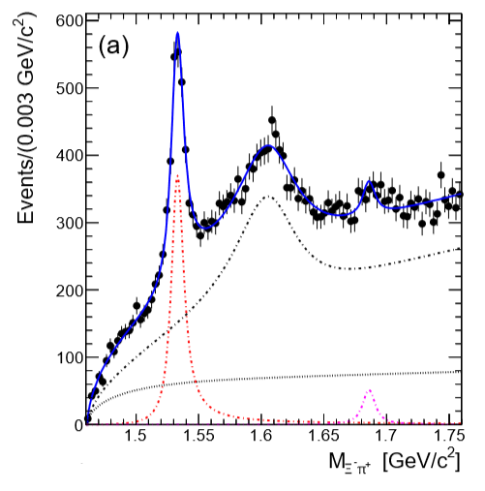
Ξ(1620/1690)
Both are strong candidates
for exotics
Molecular states?
Ξ_{c}⁺ → Ξ⁻π⁺π⁺
Ξ(1620)
Ξ(1690)
Λ_{c}→ΛK⁰_{S}K⁺
Ξ(1690)
[Belle, PRL 122 (2019) 072501]
[Belle, PLB 524 (2002) 33-43]

Slide 14
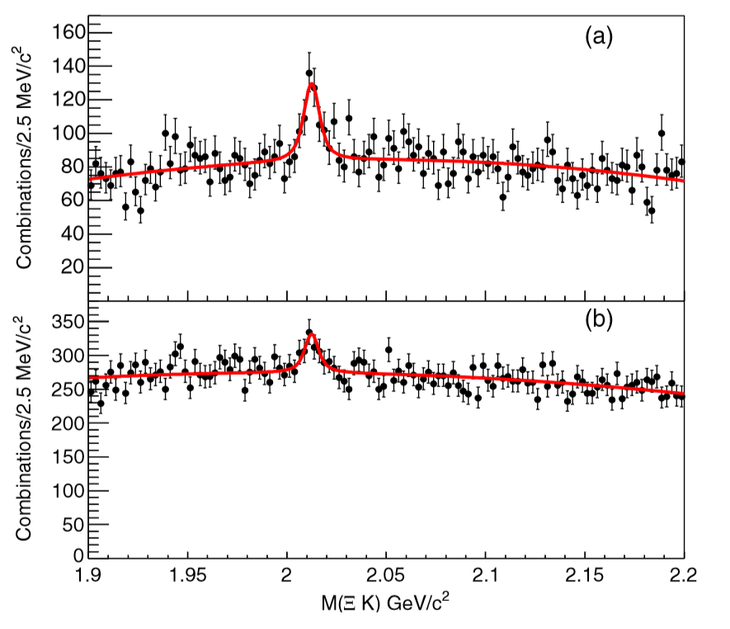



Ω(2012)
[Belle, PRL121 (2018) 052003]
Discovered in
$Υ$(1-3S) decay
& Ω_{c} decay
Conventional
1P_{3/2} state?
Ξ*(1530)K
molecule?
$$Ξ^{0}K^{−}$$
$$Ξ^{−}K_{s}^{0}$$

Slide 15
Belle to Belle II

Slide 16
SuperKEKB and Belle II
Upgrade for SuperKEKB and Belle II to achieve 30x peak L
Goal: x50 more statistics than Belle

Slide 17
Upgraded from Belle

Slide 18
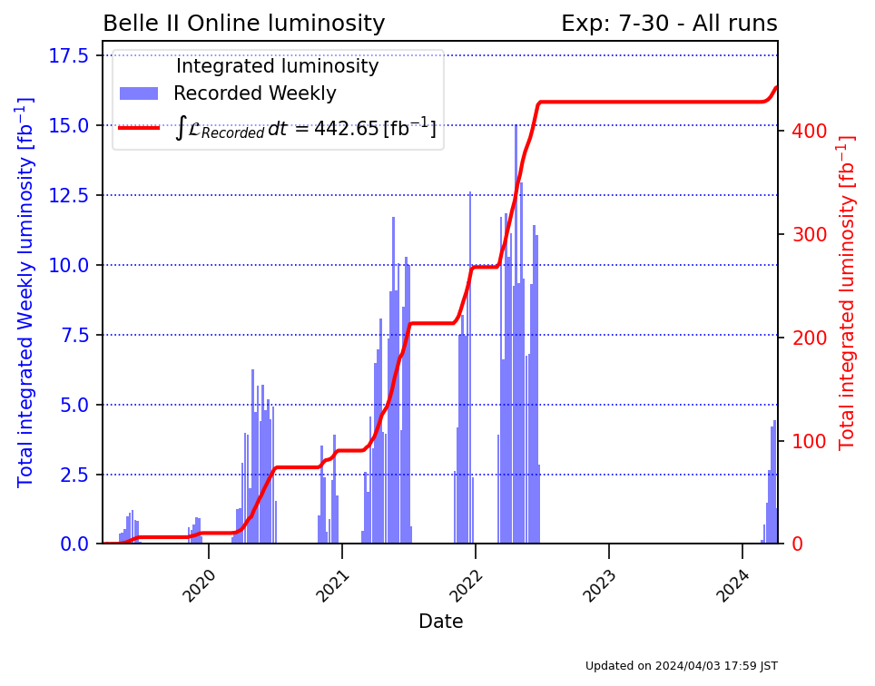
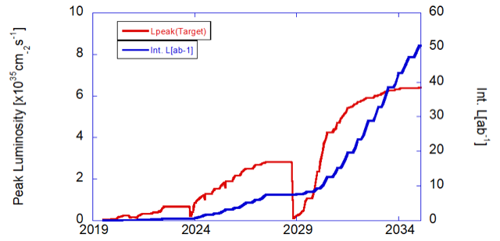
Belle II integrated luminosity
Achieved
Prospect
Total:
443 fb⁻¹
Now Run2
has begun!
Instantaneous luminosity already exceeded Belle
→ New record: 4.7x10³⁴ cm⁻²s⁻¹ in June 2022.
Integrated luminosity will exceed Belle within a few years
Goal: 50 ab⁻¹ around 2035.

Slide 19

$$Υ(10753)$$

Slide 20
Hadron Spectroscopy at EIC?

Slide 21
eA collision
Hadron production by fragmentation:
in between electron and hadron machines
  Production cross section
  Background
Direct production?
  Only case may be peripheral production of vector mesons
  Vp virtual scattering
  → pentaquark study: P_{c}, P_{s}

Slide 22
Charm hadrons?
Charm production dominated by photon-gluon fusion process
Cross section calculation by C. Weiss et al.,
  30-100 nb
  C.f., 1.1 nb in e⁺e⁻ collisions @10.6 GeV
Comparable yield with Belle II

Slide 23
Bottom hadrons?
In Belle (II), only limited number of bottom hadrons are kinematically allowed
  Especially, no bottom baryons can be produced
→ Chance for EIC
Production cross section wrt to charm
(by Matthew Kelsey (LBNL))

Slide 25
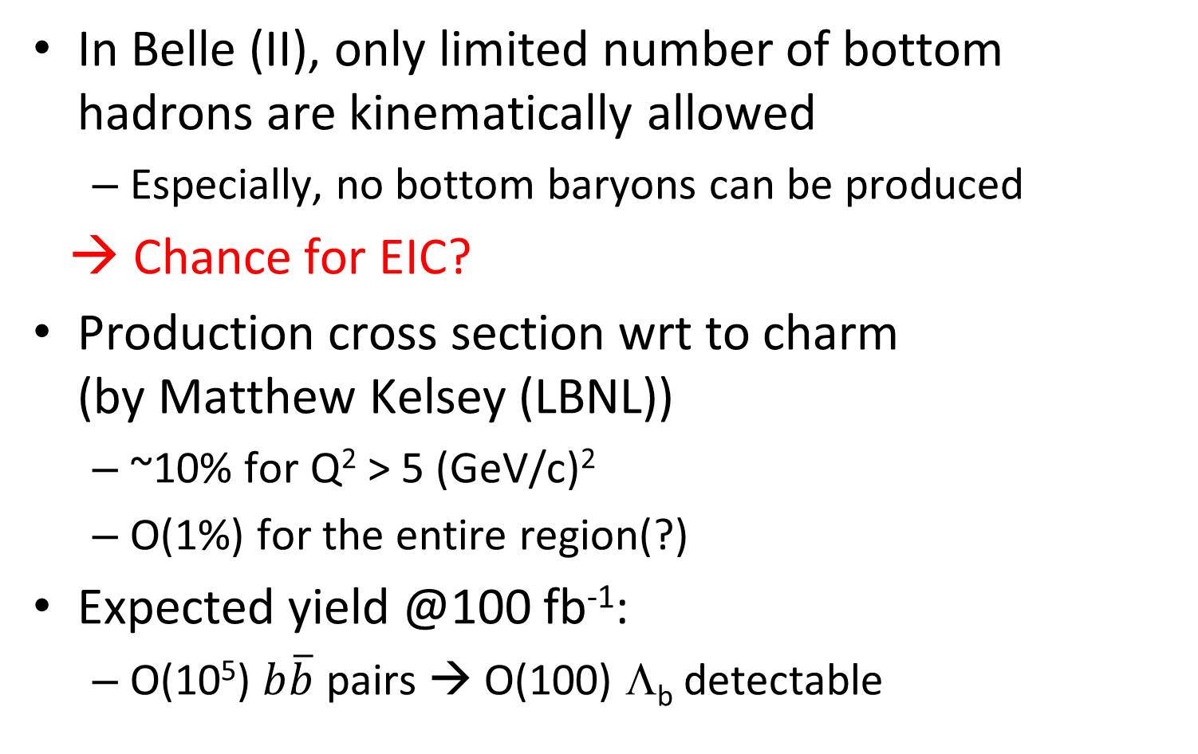
Bottom hadrons?
In Belle (II), only limited number of bottom hadrons are kinematically allowed
  Especially, no bottom baryons can be produced
→ Chance for EIC?
Production cross section wrt to charm
(by Matthew Kelsey (LBNL))
  ~10% for Q² > 5 (GeV/c)²
  O(1%) for the entire region(?)
Expected yield @100 fb⁻¹:
  O(10⁵) $b\overline{b}$ pairs → O(100) Λ_{b} detectable

Slide 26
P_{c}
Slides borrowed from
Kim Youngsun

Slide 28
[PRD 105, 114023 (2022)],
slides borrowed from Kim Youngsun

Slide 30

Z_{b}(10610/10650)
Calculation by Xiao-Yun Wang et al.,
[Chin.Phys.C 45 (2021) 5, 054102, arXiv:2009.05789]
  ep → Z_{b}n via
  $Υp→\text{Z}\text{b}\text{n}$
  O(10⁶) events
  expected
  for 200 fb⁻¹
  O(10⁴)events
  for $Z_{b}→$
  $Υ\left(nS\right)π$ $→llπ$
Good chance at EIC

Slide 31
Summary
Hadron spectroscopy: one of the important subject in Belle
  Especially those with heavy quarks
  Pioneered the new discoveries of exotic hadrons
  Studies continue in Belle II
How about EIC?
  Inclusive charm yield comparable with Belle II
  Bottom hadron may be possible (but not competitive with LHC)
  Good chance for tetra/pentaquark studies with virtual vector meson-proton scatterings

Slide 32
Backup

Slide 33
Hyperon polarization study
To measure hyperon polarization in Λ_{c} decay
  Semileptonic: Λ_{c} → Y + e(μ) + ν
  Non-leptonic: Λ_{c} → Y + π
  Main target is Y=Λ(1405)
Why it is interesting?
  s quark from charm decay is polarized
  Naively, polarization transfer from quark to hyperon
  = How much fraction of spin of hyperon is carried out by the quark. E.g., quark model predicts P(Λ)=P(s)~-0.9
  We can discuss hyperon spin structure.
  For Λ(1405), 3 quark state should have P~+0.3, while 5 quark state (or KN bound state) should have P~0.

Slide 34











Existing data (from PDG)
Λ_{c} → Λ + e(μ) + ν: P＝α＝－0.86±0.04 OK
Λ_{c} → Λ + π⁺: P＝－0.91±0.15 OK
Λ_{c} → Σ⁺ + π⁰: P＝－0.45±0.32 OK?
  Contribution of strange quark should give P~+0.3, but there is a contribution of up quark P~-0.6, giving P~-0.3 in total
$$u$$
$$u$$
$$c$$
$$s$$
$$Σ^{+}$$
$$u$$
$$W$$
$$\overline{d}$$
$$π^{0}$$
$$d$$
$$d$$
Seemingly, the naïve model can explain the existing data

Slide 35
Semileptonic vs nonleptonic modes
Theoretical cleanness vs experimental easiness
Semileptonic: no peak in invariant mass because of missing ν.
  BG may be severe, very complicated analysis
  Tagging Λ_{c} in missing mass?
  Up to 100 counts in the present Belle, a few thousands expected in Belle II.
  → Detection may be possible with Belle data,
  polarization needs Belle II statistics
Non-leptonic:
  Study possible with Belle data, but interpretation is the issue
  Measure mass dependence → identify 2-pole structure??
  Λ(1520) as a control sample

Slide 36

Energy scan ~10.751 GeV
$Υ$(10753)?
  Hints in $Υ$(nS)ππ &
  inclusive $b\overline{b}$ data
  Significance 5.2σ
  Exotic? Conventional?
[Chin. Phys. C 44 8, 083001 (2020)]
[Belle, JHEP10(2019)220]

Slide 37
What is it?

