Slide 1
格子QCDの量子計算に向けて
Arata Yamamoto (University of Tokyo)

Slide 2
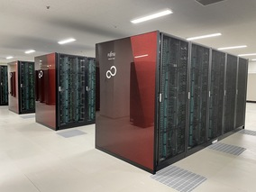
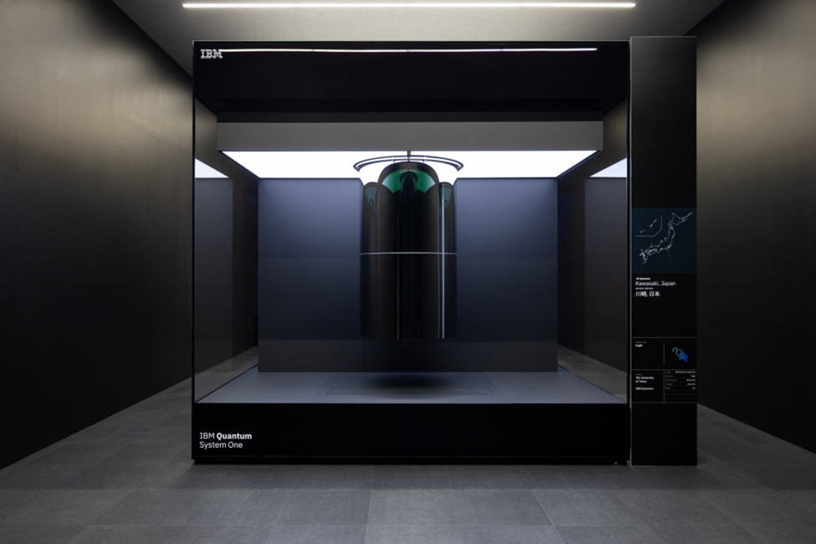
Introduction
©︎ UTokyo
supercomputer
©︎ IBM
lattice QCD
quantum computer

Slide 3
Introduction
open problems in lattice QCD
non-equilibrium process
nuclear many-body system

Slide 4
Introduction
non-equilibrium process
path integral simulation
$$Z=\int{e^{iS}}$$
sign problem
cost $∼e^{poly(V)}$
Hamiltonian simulation
$${\left|final\right\rangle =e}^{−iHt}|initial⟩$$
cost $∼e^{poly\left(V\right)} → poly(V)$ on QC
$e^{poly\left(V\right)}×e^{poly\left(V\right)}$ matrix

Slide 5
Introduction
nuclear many-body system
(or nonzero density)
grand canonical simulation
$$Z_{μ}=\int{e^{−S}detD(μ)}$$
sign problem
cost $∼e^{poly\left(V\right)}∼e^{poly(A)}$
canonical simulation
$$Z_{A}=\int{e^{−S}detD}\{ψψ⋯\}\{\overline{ψ}\overline{ψ}⋯\}$$
no sign problem?
$3A$ quarks
$3A$ antiquarks

Slide 6
Introduction
nuclear many-body system
(or nonzero density)
grand canonical simulation
$$Z_{μ}=\int{e^{−S}detD(μ)}$$
sign problem
cost $∼e^{poly\left(V\right)}∼e^{poly(A)}$
Yamamoto (2021) Tomiya (2022)
canonical simulation
$$Z_{A}=\int{e^{−S}detD}\{ψψ⋯\}\{\overline{ψ}\overline{ψ}⋯\}$$
cost $∼e^{poly\left(A\right)} → poly(A) \text{on} \text{QC}$
Yamamoto, Doi (2024)
$3A$ quarks
$3A$ antiquarks

Slide 7
Current status
©︎ IBM
error mitigation
error correction
noisy intermediate-scale quantum (NISQ) device

Slide 8
Current status
lattice QCD roadmap
2024
2032 ~
20XX ~
NISQ or emulator
usage proposal
algorithm design
small-scale QC
toy model of QCD
large-scale QC
real QCD

Slide 9
Current status
open issues:
toy models:
error robust algorithm
resource efficient algorithm
qubit encoding of SU(3)
cost of continuum limit
artificial gauge symmetry breaking
chiral anomaly
3 dimensions $→$ 1 dimension
continuous gauge $→$ discrete gauge
pure gauge or pure fermion theory

Slide 10
Toy model of QCD
fermion field
$\left|ψ\right\rangle =c_{0}\left|empty\right\rangle +c_{1}\left|occupied\right\rangle ↔$ 1 qubit

Slide 11
Toy model of QCD
fermion field
$\left|ψ\right\rangle =c_{0}\left|empty\right\rangle +c_{1}\left|occupied\right\rangle ↔$ 1 qubit
$Z_{2}$ gauge field
$$\left|U\right\rangle =c_{0}\left|+1\right\rangle +c_{1}\left|−1\right\rangle$$
$Z_{3}$ gauge field
$$\left|U\right\rangle =c_{0}\left|e^{i0}\right\rangle +c_{1}\left|e^{i2π/3}\right\rangle +c_{2}\left|e^{i4π/3}\right\rangle$$
$$⋯$$
$Z_{n}$ gauge field
$$\left|U\right\rangle =c_{0}\left|e^{i0}\right\rangle +c_{1}\left|e^{i2π/n}\right\rangle +⋯+c_{n−1}\left|e^{i2π(n−1)/n}\right\rangle$$
U(1) gauge field
$∞$dimension !! SU(3) is more complicated...
$$n→∞$$

Slide 12
Toy model of QCD
Florio, Weichselbaum, Valgushev, Pisarski (2023)
Hidaka, Tanizaki, Yamamoto (2024)
SU(3) $→Z_{3}$ lattice gauge theory
$$electric charge=0, 1, 2 (mod 3)$$
$$u$$
$$u$$
$$u$$
$$u$$
$$u$$
$$u$$
$$\overline{d}$$
$$u$$
$$d$$
$$d$$
$$d$$
quark
two quarks
proton
neutron
pion

Slide 13
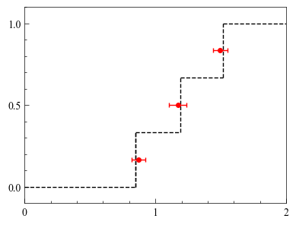
Toy model of QCD
Hidaka, Tanizaki, Yamamoto, in prep.
SU(3) $→Z_{3}$ lattice gauge theory
emulator
$$u$$
baryon density
$$d$$
$$s$$
exact
3-flavor baryon in 1 dimension
chemical potential

Slide 14
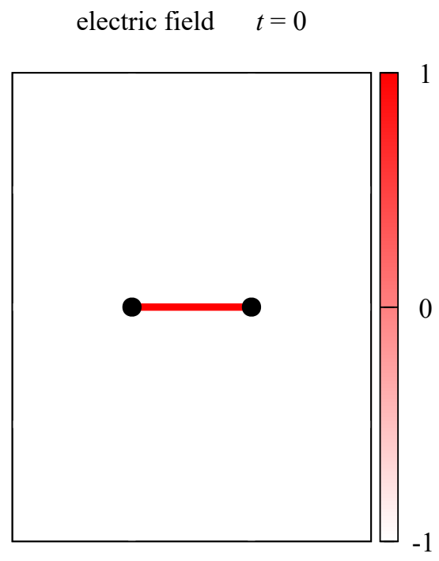
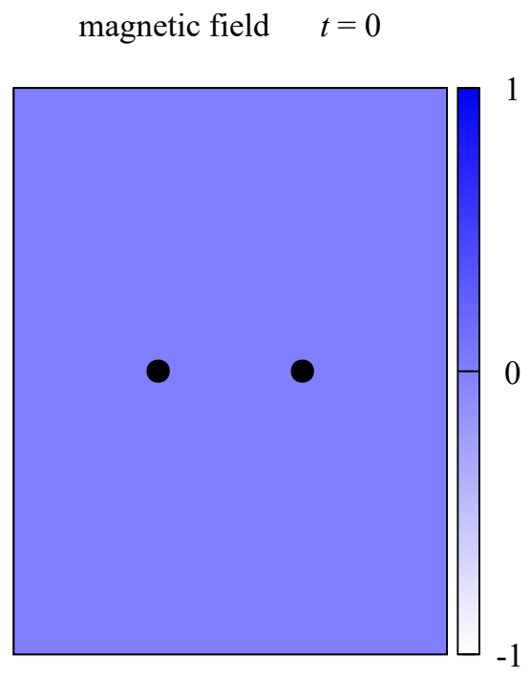
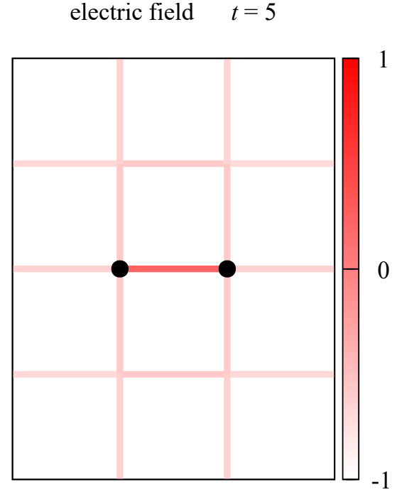
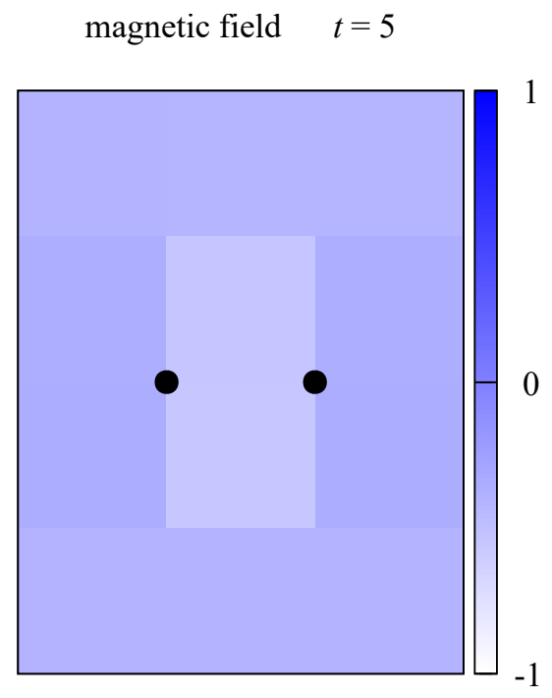
Real-device quantum simulation
Yamamoto (2021)
time evolution of 2-dim. $Z_{2}$ pure gauge theory
initial state $t=0$
$$t>0$$
electric field
magnetic field
electric field
magnetic field
time evolution
2 static charges (~ heavy quarks)

Slide 15
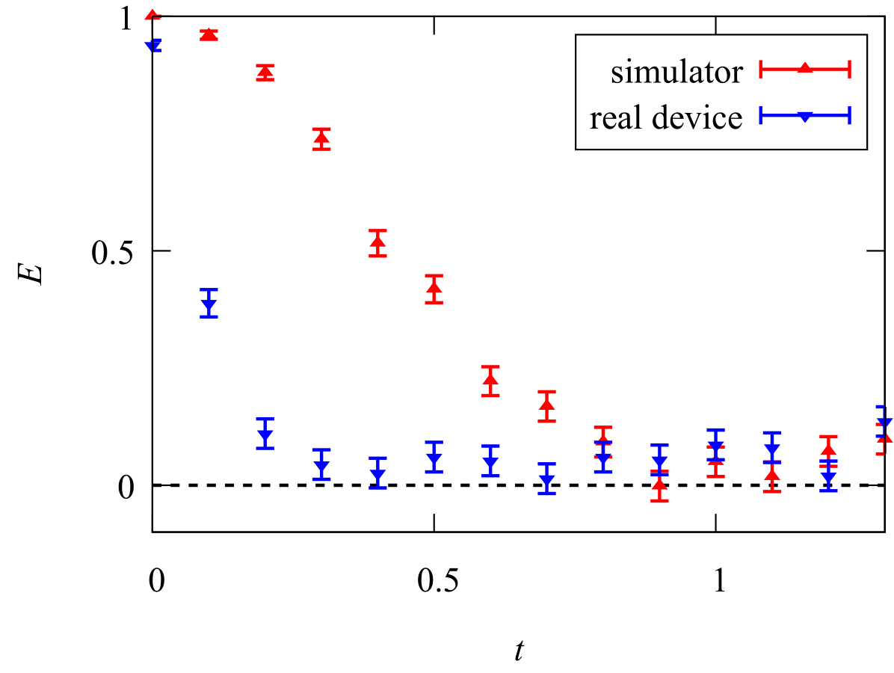
Real-device quantum simulation
Yamamoto (2021)
time evolution of 2-dim. $Z_{2}$ pure gauge theory
classical: emulator
quantum: 12 qubits w/o error mitigation
emulator
electric string energy
QC
device error is harmful
time

Slide 16
Real-device quantum simulation
Farrell, Illa, Ciavarella, Savage (2024)
time evolution of 1-dim. QED
initial state $t=0$
$$e^{+ } e^{−}$$
vacuum +$e^{+ }e^{−}$

Slide 17
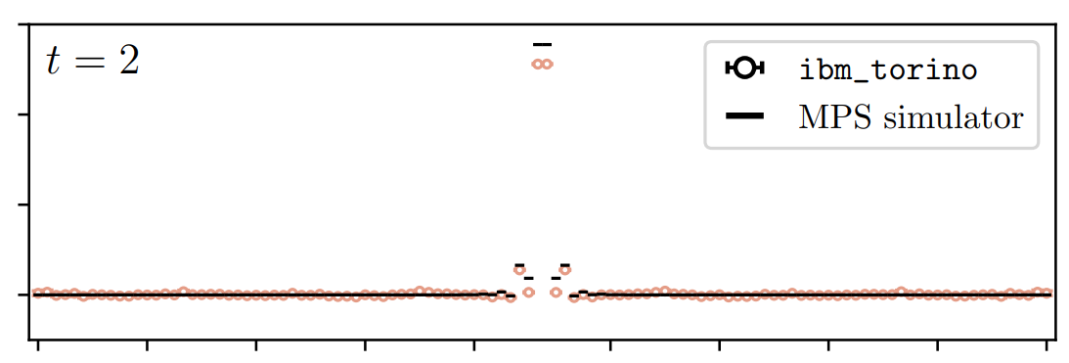
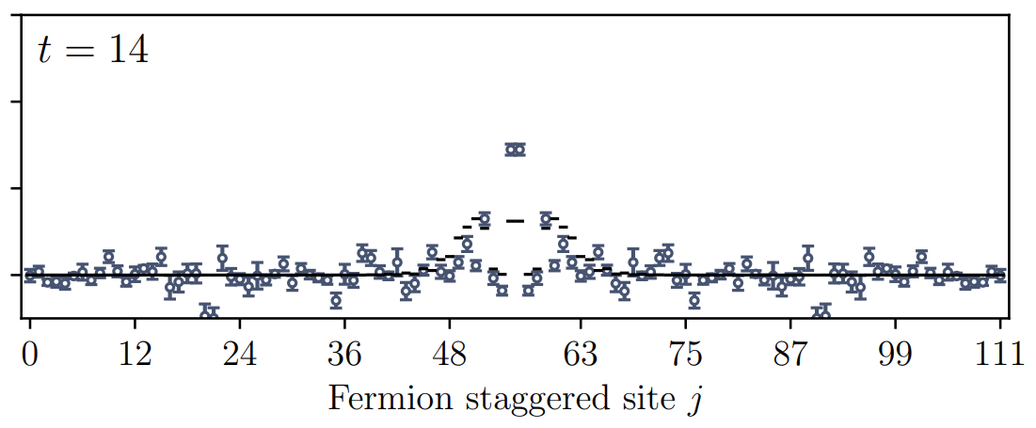
Real-device quantum simulation
Farrell, Illa, Ciavarella, Savage (2024)
time evolution of 1-dim. QED
classical: tensor network simulation
quantum: 112 qubits with error mitigation
qualitatively consistent, but systematic errors

Slide 18
Summary
Quantum computing of lattice QCD
Current status (2024) : usage proposal, algorithm design
Near-future application (2032~): toy model of QCD
Far-future application (20XX~): real QCD

