Slide 1
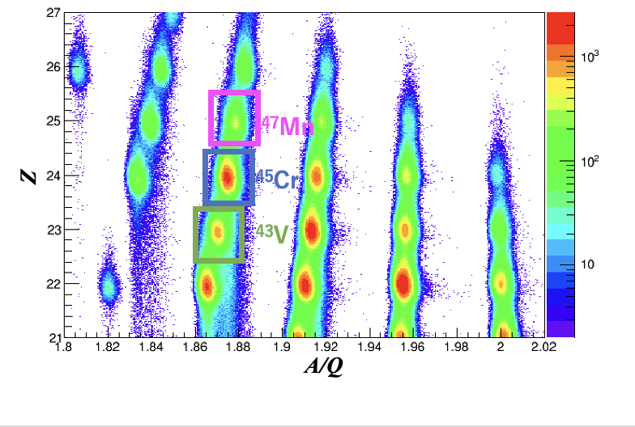
Half-life measurement of 107-keV isomeric state in ⁴⁵Cr
Tokyo City University
1st grade of master course
Mei Amitani
for SHARAQ13 collaboration
Particle identification plot in this experiment

Slide 2
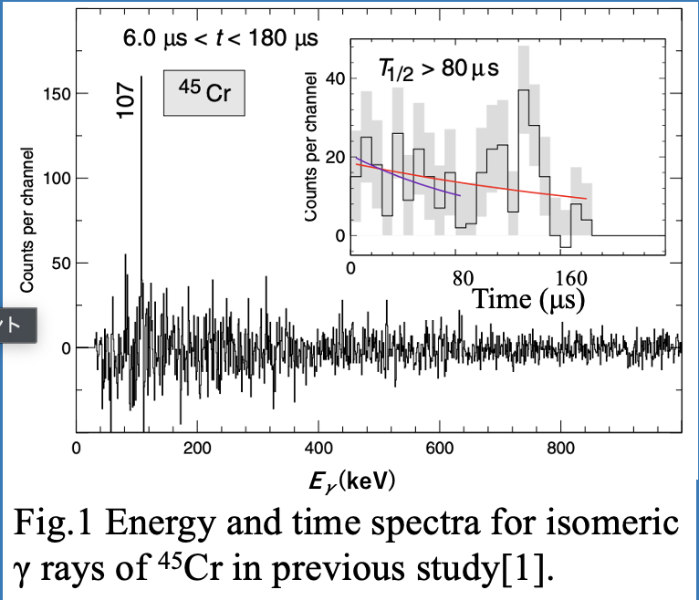
Introduction
In the previous study at GSI, the 107-keV isomeric state in ⁴⁵Cr was discovered.
However, only the upper limit (80μs) of T_{1/2} of the isomeric state in ⁴⁵Cr was reported.
[1] R. Hoischen et al., J. Phys. G: Nucl. Part. Phys.38,(2011) 035104.

Slide 3
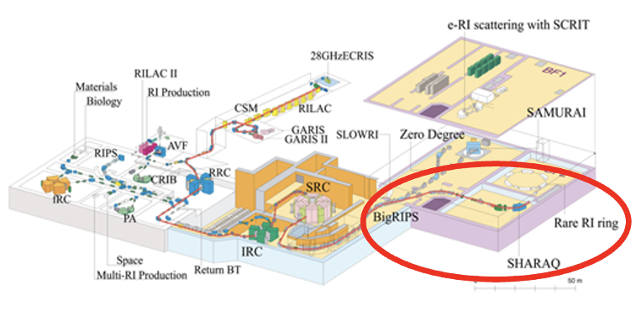
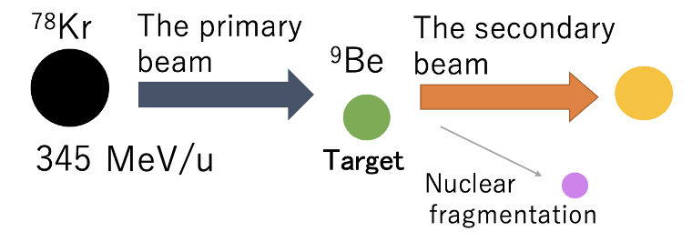
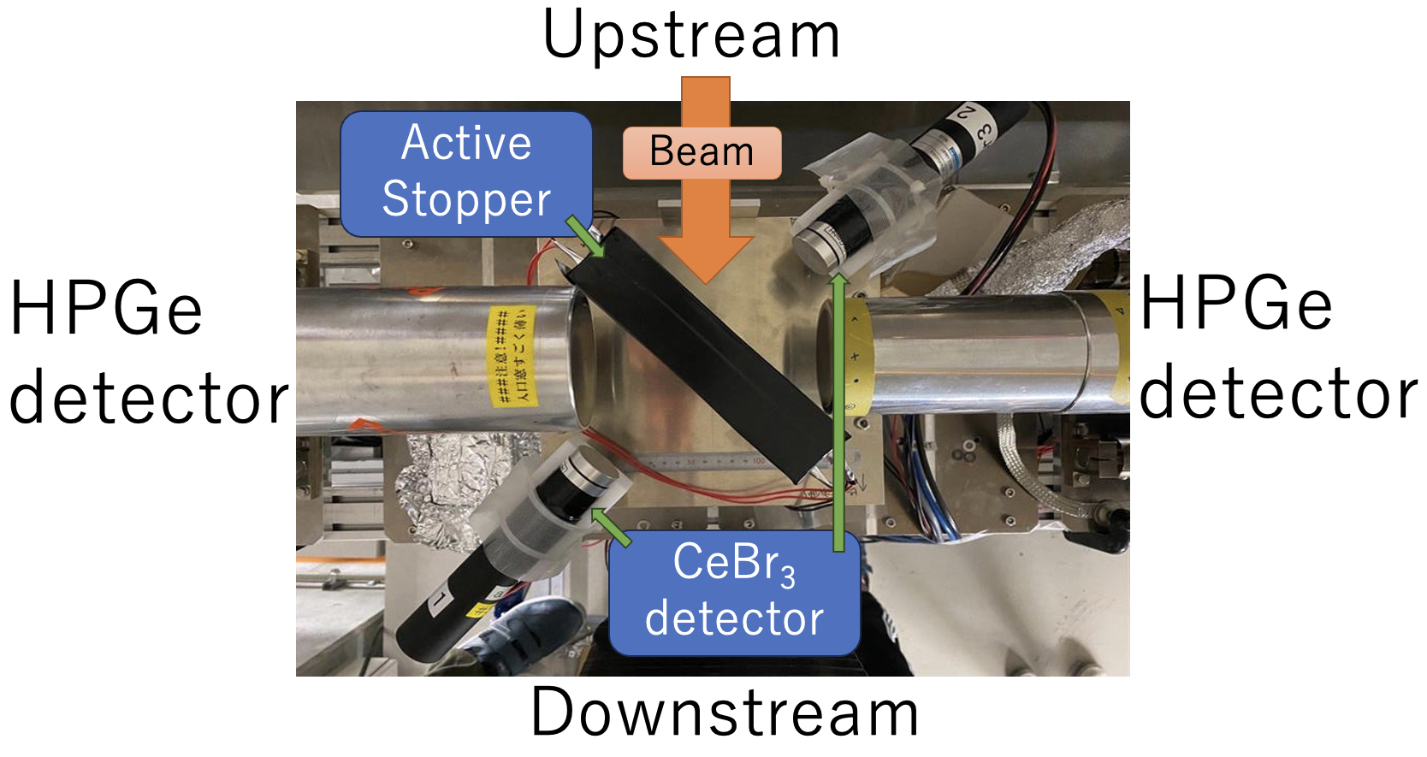
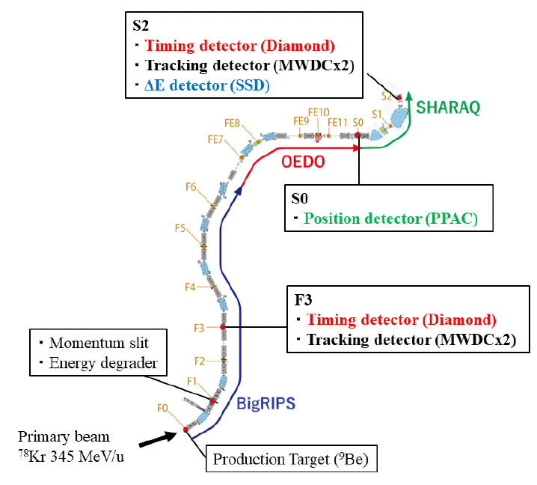
Experimental Methods

Slide 4
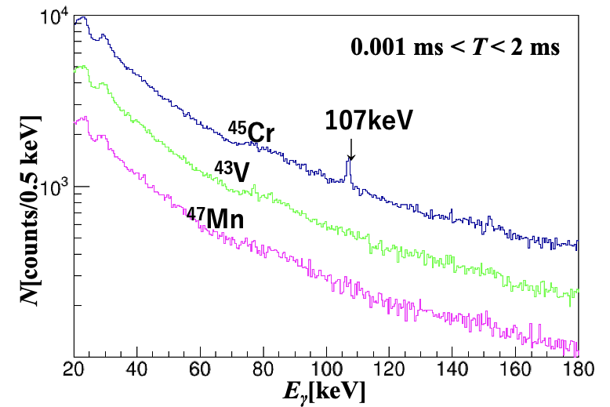
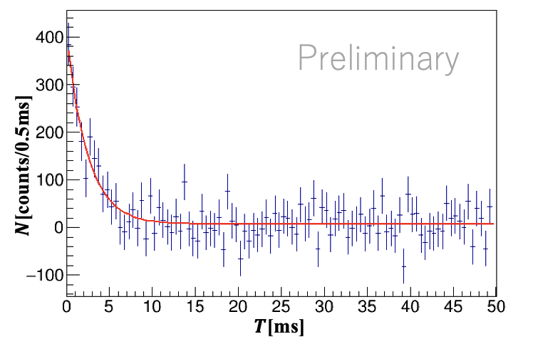
Results
T_{1/2} = 1.7±0.2(sta.) ms
Energy spectra of gamma rays followed by the implantation of ⁴³V, ⁴⁵Cr and ⁴⁷Mn.
The time window after the implantation of the RI beams was opened from 1μs to 2 ms.
Time spectrum of the 107-keV gamma rays in ⁴⁵Cr.

