Slide 1
Bound and scattering states of the electron wavefunctions calculated with the Dirac equation for 0νββ
Atsuya Kanai
Collaborator, Nobuo Hinohara
Nuclear theory group, Center for Computational Sciences, University of Tsukuba
Notes:
Thank you for introduce. I would like to begin my presentation.

Slide 2
Double-beta decay
・ In some nuclei, two neutrons (or protons) simultaneously undergo beta decay
・ Fermi particles that do not distinguish between particles and antiparticles
Majorana particles
・Neutrinos may be Majorana particles
Double beta decay without emitting neutrinos is allowed
(Neutrino-less double-bata decay、0νββ)
48Ca 76Ge82Se
etc…
…
Notes:
First, let me explain double beta decay. In some nuclei like these, two neutrons or protons simultaneously undergo beta decay, a reaction known as double beta decay. In this case, two neutrinos are emitted, and it is said that neutrinos may be Majolana particles, a group of Fermi particles that do not distinguish between particles and antiparticles. In that case, double beta decay without emitting neutrinos is allowed, which is called neutrino-less double beta decay or $0νββ$.

Slide 3
Phase space factor
Nuclear matrix element
・For 0νββ we have following equation
Phase space factor
Half-life
Effective neutrino mass
Axial vector coupling constant
Electron mass
Effective neutrino mass can be determined by calculating nuclear matrix element and phase space factor
・ Want to calculate phase space factor
Requires wave functions of high-energy (fast) electrons emitted at 0νββ
Need to solve Dirac equation!
Notes:
For $0νββ$ we have following equation. This equation relates the half-life of $0νββ$ to the effective neutrino mass. The values of me and maybe gA are already known. So, the effective neutrino mass can be determined by experimentally measuring the half-life and theoretically calculating nuclear matrix element and phase space factor.
My final objective in this study was to calculate the phase space factor. The calculation of the phase space factor requires wave functions of high-energy fast electrons emitted at $0νββ$, so we need to solve Dirac equation, which is an equation of relativistic quantum mechanics.

Slide 4
Purpose of the study
In preparation of phase space factor calculation…
・Calculate the wavefunction of the electron in the bound states for the hydrogen atom, and compare the obtained energies and the wavefunction with the analytical solutions
・Calculate the wavefunction of the electron in the scattering states for the nucleus undergoing double-beta decay
Notes:
Therefore, in preparation of phase space factor calculation, we first calculated the wavefunctions of electrons in the bound states for hydrogen atoms and compared the obtained energies and wavefunctions with analytical solutions. And then calculated the wavefunctions of electrons in the scattering states for nucleus undergoing double-beta decay.

Slide 5


Dirac equation in central field
・ In central field, wavefunction can be product of radial and angular wavefunction
$$j=l±1/2$$
・ The radial part satisfies the following simultaneous differential equations
$$V\left(r\right)=\frac{1}{4πε_{0}}\frac{Ze^{2}}{r}$$
・κ is relativistic quantum number
・ Solve this equation using the fourth-order Runge-Kutta method
Notes:
Next, I’ll explain Dirac equation in central field. In relativistic quantum mechanics, wavefunction psi is 4-dimensional spinor. And in central field, wavefunction can be a product of radial and angular wavefunction like this. The radial part satisfies these simultaneous differential equations. Where κ is the relative quantum number, which is determined by l and j. We solved this equation using the fourth-order Runge-Kutta method.

Slide 6
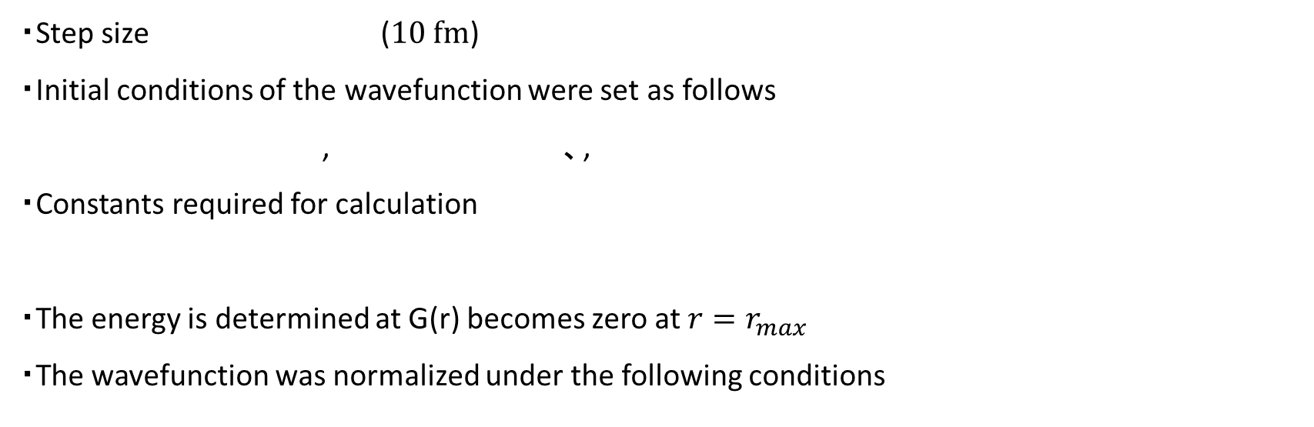
Calculation of bound states
To calculate the radial wavefunctions of bound electrons…
・Solved from $r=Δr$ up to $r_{max}=10 Å$ (${10}^{6} fm)$
・Step size ($10 fm$)
・Initial conditions of the wavefunction were set as follows
, 、,
・Constants required for calculation
・The energy is determined at G(r) becomes zero at $r=r_{max}$
・The wavefunction was normalized under the following conditions
Notes:
Since potentials and other factor diverge at the origin, we solved from r=delta r. And we calculated the wavefunctions by using these conditions.

Slide 7


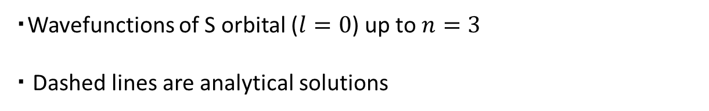

Wavefunctions（S orbital）
0.001
2S_{1/2}
3S_{1/2}
・Wavefunctions of S orbital ($l=0$) up to $n=3$
・ Dashed lines are analytical solutions
0
F(r) ($Å$)
1S_{1/2}
-0.004
0
10
r ($Å$)
1.2
1S_{1/2}
1S is almost identical to the analytical solution
As n increases, the wave function spreads farther
G(r) ($Å$)
0
3S_{1/2}
2S_{1/2}
-0.8
0
10
r ($Å$)
Notes:
Next, I’ll show the calculation results. These are figures showing the radial wavefunctions of S orbitals, that is, l=0, up to n=3. The dashed line is the exact solution of the wavefunction for the 1S orbital, which is represented by the equation like this. Where, large Γ is the gamma function, and the small γ is such a quantity. For 1S orbital, the calculated wavefunctions and exact solutions are in very good agreement. Also, as n increases, the wavefunction spreads farther.

Slide 8
Calculation results（S orbital）
・Comparison of binding energies [eV] of S orbitals up to n=3
analytical solutions
・Analytical solutions (relativistic, non-relativistic)
1S orbitals match in 7 digits of accuracy
As n increases, accuracies of the energies got worse
Notes:
The next table compares the binding energies of S orbitals for the calculation results, relativistic analytical solution, and non-relativistic analytical solution. For the calculation results and the relativistic analytical solutions, the binding energy is shown as the energy eigenvalue minus the electron mass energy. The relativistic and non-relativistic analytical solutions are expressed in these equations. The table shows that 1S orbitals match in 7 digits of accuracy, and as n increases, accuracies of the energies got worse. This is probably due to the fact that the wavefunction is spreading farther and farther, and the value has not yet fallen off, yet we have found an energy that is zero at 10 Å.

Slide 9

Calculation of scattering state
To calculate the radial wavefunctions of scattering electrons…
・48Ti, daughter nucleus of double-beta decay of 48Ca
・ The energy of the electron is set to be $E=2$ MeV
・The coordinates of the nth point are set so that $r_{n}=0.001{(e}^{0.00005n}−1) Å$
・ Potential was changed as follows (assuming charge distribution of nuclei as uniform sphere)
$$V\left(r\right)=\left\{\begin{aligned}−Zαℏc\left(\frac{3−{\left(r/R\right)}^{2}}{2R}\right), r<R \\ −\frac{Zαℏc}{r}, r≥R\end{aligned},\right. R=1.2A^{1/3} fm$$
Because we need the values of the wavefunction at the surface of the nucleus for the calculation of phase space factor and also need to fit analytical solutions to the calculated wavefunctions
Notes:
Next, we calculated the wavefunctions of scattering states. In this study, we calculated for Ti48, which is daughter nucleus of double-beta decay of Ca48. The energy was set to 2 MeV. I also set the coordinates like this. This is because we need the values of the wavefunction at the surface of the nucleus for the calculation of the phase space factor and also need to fit analytical solutions to the calculated wavefunctions. We also assumed charge distribution of the nucleus as uniform sphere, and changed the potential in this way. Where R is nuclear radius.

Slide 10




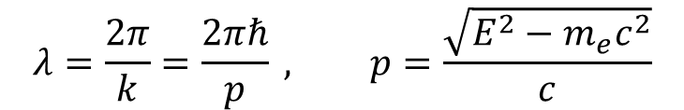


Wavefunctions near the origin
0.0008
Oscillate at a very short wavelength (about 600 fm)
As expected, the wavelength is calculated from the energy to be about 600 fm
As expected, roughly three periods of waves are showing
Almost in the form of a plane wave, but F(r) behaves quadratically near the origin
F(r) ($Å$)
0
$$λ=\frac{2π}{k}=\frac{2πℏ}{p} , p=\frac{\sqrt{E^{2}−m_{e}c^{2}}}{c}$$
-0.0008
0
0.02
$R=4.36$ fm
r ($Å$)
0.001
G(r) ($Å$)
0
-0.001
0
0.02
$R=4.36$ fm
r ($Å$)
Notes:
Next, I’ll show figures of calculated wavefunctions near the origin. The nuclear radius is here. Because the energy is very high, the wavefunctions oscillate at a very short wavelength about 600 fm. And as expected, the wavelength is calculated from the energy to be about 600 fm. We can see about three periods of waves. And the wavefunctions are almost in the form of a plane wave, but F(r) behaves quadratically near the origin.

Slide 11

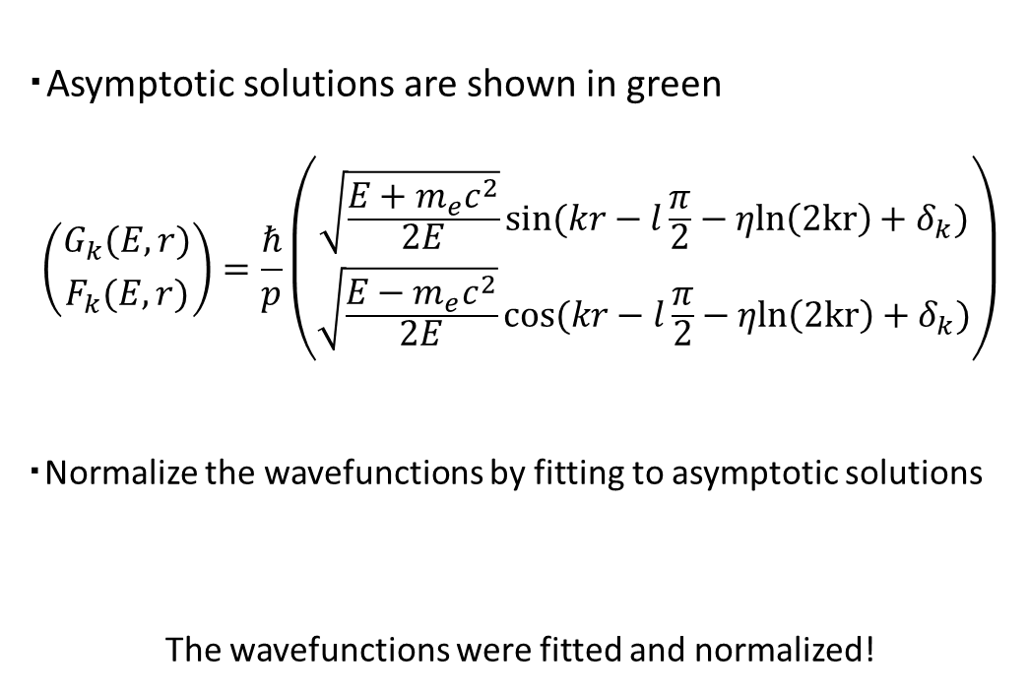

Wavefunctions around 5Å
0.0008
・Asymptotic solutions are shown in green
$$\left({G_{k}(E,r) \atop F_{k}(E,r)}\right)=\frac{ℏ}{p}\left({\sqrt{\frac{E+m_{e}c^{2}}{2E}}sin(kr−l\frac{π}{2}−ηln\left(2kr\right)+δ_{k}) \atop \sqrt{\frac{E−m_{e}c^{2}}{2E}}cos(kr−l\frac{π}{2}−ηln\left(2kr\right)+δ_{k})}\right)$$
・Normalize the wavefunctions by fitting to asymptotic solutions
The wavefunctions were fitted and normalized!
F(r) ($Å$)
0
-0.0008
4.98
5
r ($Å$)
$δ_{k}=π/2$, $η=Ze^{2}/ℏv$
0.001
G(r) ($Å$)
0
-0.001
4.98
5
r ($Å$)
Notes:
Next, I’ll show figures of the wavefunctions around 5Å. Shown in green is the asymptotic solution represented by the equation shown here. Where δk is the phase shift, and η is a quantity called the Sommerfeld parameter. We need the value of normalized wavefunctions at nuclear radius. So, we multiplied the calculated wave function by a constant so that the amplitude matches the asymptotic solution. I also determined the value of δk so that the phase of the asymptotic solution matches the calculated wavefunction. In this case, δk=π/2.

Slide 12
Summary
・In preparation of phase space factor calculation, we calculated wavefunctions and energies of electrons in the bound state for the hydrogen atom
・For 1S orbital, wavefunctions and energy eigenvalue are well matched to exact solutions
・For S orbitals which n = 2, 3, the accuracy of calculations is not good
・Then the wavefunctions of electrons in the scattering states for 48Ti
・Calculated wavefunctions and asymptotic solutions are matched
・Incorporate screening effect of surrounding electrons into the potential
・Incorporate (if possible) many-body effects due to surrounding electrons
・Calculate phase space factor
Future Issues
Notes:
Summary. In preparation of phase space factor calculation, we calculated wavefunctions and energies of electrons in the bound state for the hydrogen atom. For 1S orbital, wavefunctions and energy eigenvalue are well matched to exact solutions. For S orbitals which n = 2, 3, the accuracy of calculations is not good. Then the wavefunctions of electrons in the scattering state for 48Ti.
Future issues would be to incorporate screening effect of surrounding electrons into the potential, and if possible, incorporate many-body effects due to surrounding electrons , and finally calculate phase space factors.
That’s all. Thank you.

Slide 13
Calculation results（48Ca）
・F(r) of electrons in the scattered state at 48Ca
・G(r) of electrons in the scattered state at 48Ca
・The wavelength is calculated from the energy to be approximately 0.006 Å (600 fm)

Slide 14
Dirac equation
・ Dirac equation for bound electrons of an atom with atomic number Z
・ α and β satisfy the following relation
・Simple example

Slide 15
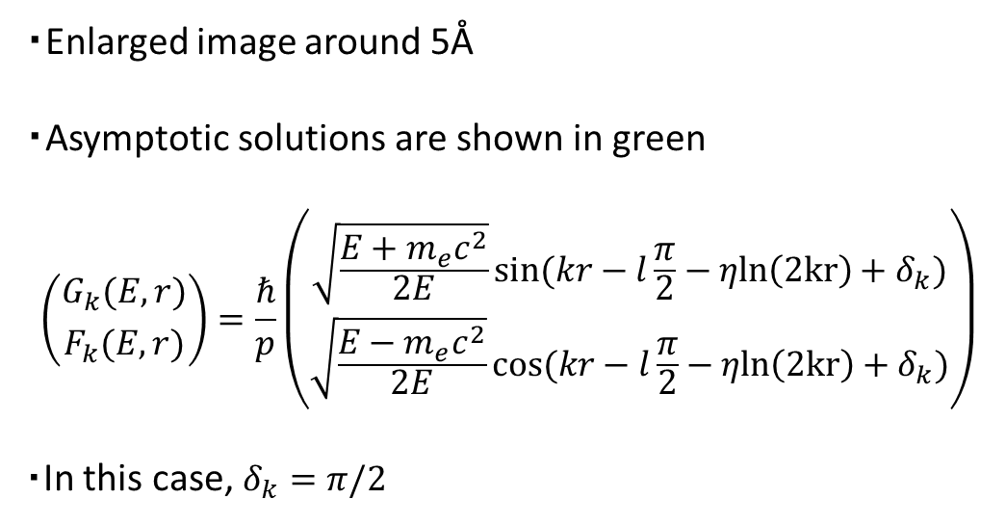
Calculation results (48Ca)
・Enlarged image around 5Å
・Asymptotic solutions are shown in green
$$\left({G_{k}(E,r) \atop F_{k}(E,r)}\right)=\frac{ℏ}{p}\left({\sqrt{\frac{E+m_{e}c^{2}}{2E}}sin(kr−l\frac{π}{2}−ηln\left(2kr\right)+δ_{k}) \atop \sqrt{\frac{E−m_{e}c^{2}}{2E}}cos(kr−l\frac{π}{2}−ηln\left(2kr\right)+δ_{k})}\right)$$
・In this case, $δ_{k}=π/2$

Slide 16
Calculation results（48Ca）
・ Enlarged image of the area near the origin
（Given the calculated wavelengths, about 3 wavelengths）
・ As expected, roughly three periods of waves are showing
・Almost in the form of a sin wave, but F(r) behaves quadratically near the origin

Slide 17
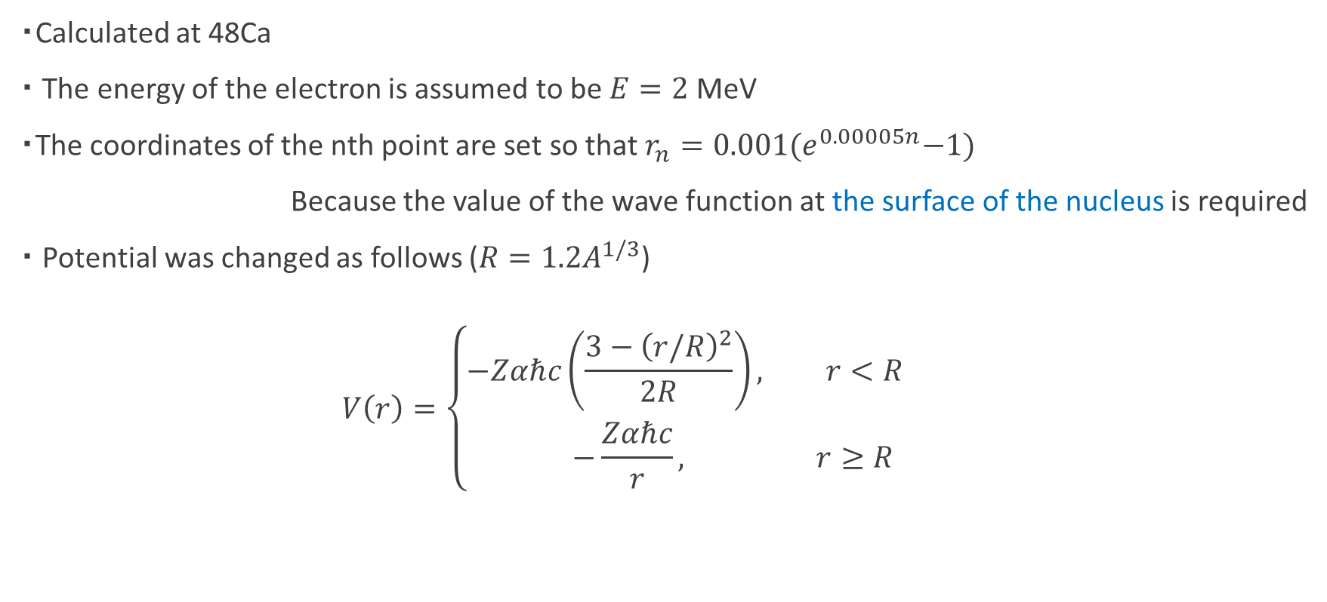
Calculation of scattering state
・Calculated at 48Ca
・ The energy of the electron is assumed to be $E=2$ MeV
・The coordinates of the nth point are set so that $r_{n}=0.001{(e}^{0.00005n}−1)$
Because the value of the wave function at the surface of the nucleus is required
・ Potential was changed as follows ($R=1.2A^{1/3}$)
$$V\left(r\right)=\left\{\begin{aligned}−Zαℏc\left(\frac{3−{\left(r/R\right)}^{2}}{2R}\right), r<R \\ −\frac{Zαℏc}{r}, r≥R\end{aligned}\right.$$

Slide 18
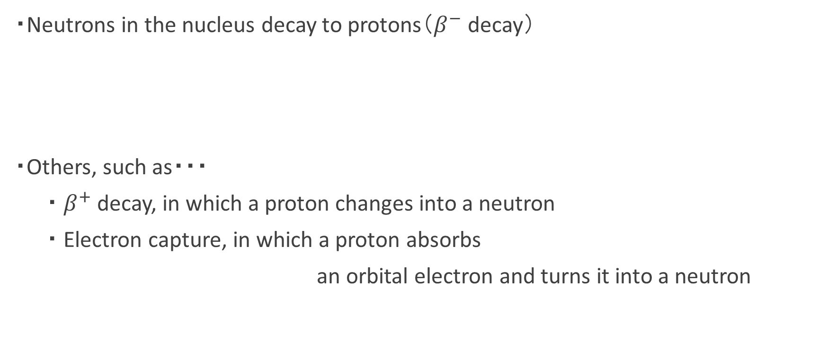
Beta decay
・Neutrons in the nucleus decay to protons（$β^{−}$ decay）
・Others, such as・・・
・ $β^{+}$ decay, in which a proton changes into a neutron
・ Electron capture, in which a proton absorbs
an orbital electron and turns it into a neutron

Slide 19
Calculation results （P orbital）
・F(r) for P orbitals up to n=3
・G(r) for P orbitals up to n=3
・As with the S orbitals, the larger the value of n, the more spread out the wave function
・G(r) is almost independent of the value of j
Due to less influence of relativity?
2P_{1/2}
3P_{1/2}
3P_{3/2}
2P_{3/2}
2P
3P

Slide 20
Calculation results （P orbital）
・ Comparison of binding energies of P orbitals up to n=3
・ As with S orbitals, the larger n, the less it matches
・The fine structure is showing

Slide 21
Calculation results （D orbital）
・ F(r) of D orbitals at n=3
・ G(r) of D orbitals at n=3
・The wave function is quite spread out
・ As with the P orbitals, G(r) is almost the same independent of the value of j
3D_{3/2}
3D_{5/2}
3D

Slide 22
Calculation results （D orbital）
・Comparison of binding energies of D orbitals at n=3
・ Wave function spreads and boundary conditions cause the value to be shifted
・ Similar to P orbitals, fine structure appears

