Slide 1
A3F-CNS Summer School, RIKEN Nishina, 2023-08-07
Spectroscopic study of neutron-rich Ru isotopes
Jizhi Zhang
Supervisor: Prof. Zhihuan Li
Department of Physics, Peking University, China

Slide 2
Contents
Introduction
Experimental setup
Results
Discussion

Slide 3
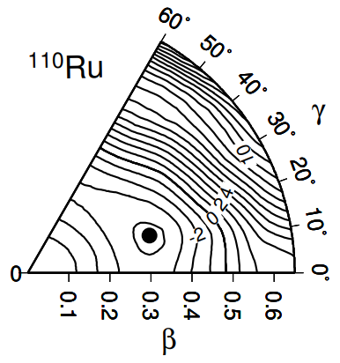
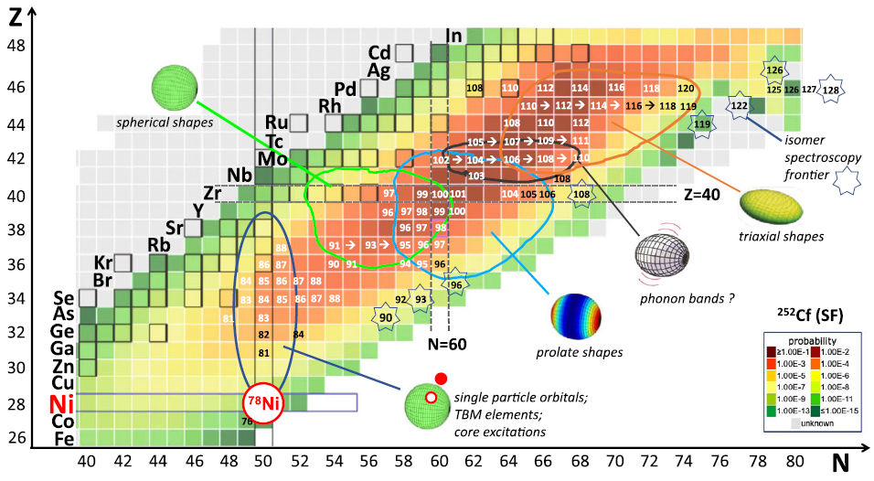
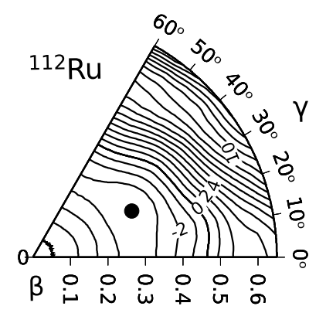
Introduction
Few stable oblate shapes in chart of nuclides
A~110 region: Well-known shape transition area
Leoni et al., Riv. Nuovo Cim. 45, 461 (2022)
Ch. Droste et al., Eur. Phys. J. A. 22, 179 (2002)

Slide 4
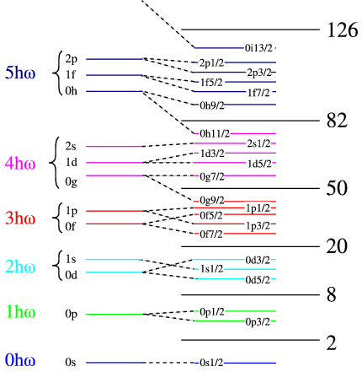
Introduction
A~110 region: Well-known shape transition area
The stability of oblate shapes will be strengthened when N > 70 (theory)
Target: ¹¹⁵Ru ¹¹⁷Ru (N = 71, 73)
70
N = 70
Leoni et al., Riv. Nuovo Cim. 45, 461 (2022)
F. R. Xu et al., Phys. Rev. C 65, 021303 (2002)

Slide 5
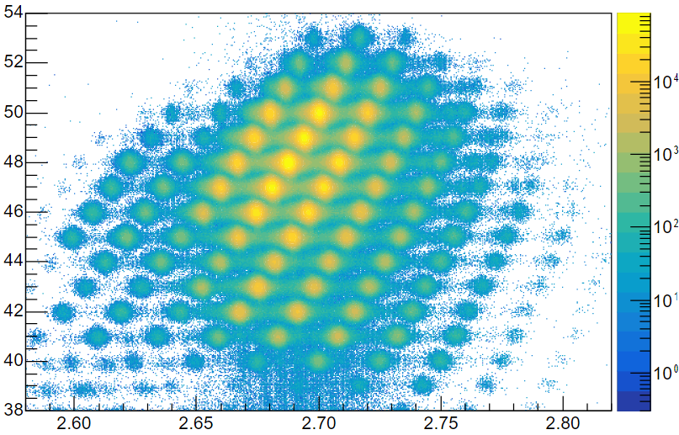
Experimental setup
RIBF @ RIKEN Nishina
WAS3ABi + EURICA array
Z
Beam identification
Neutron-rich radioactive beam was produced by induced fission of ²³⁸U
ΔE-Bρ-TOF method (for beam identification)
$6.0×{10}^{6}$ $115Tc → 115Ru$
$0.8×{10}^{6}$ $117Tc → 117Ru$
The beam finally implanted into WAS3ABi array and went through β-decay
$$β^{−}$$
$$β^{−}$$
$$115Tc$$
$$117Tc$$
A/Z
T. Kubo et al., Nucl. Instr. and Meth. B 204, 97 (2003)

Slide 6
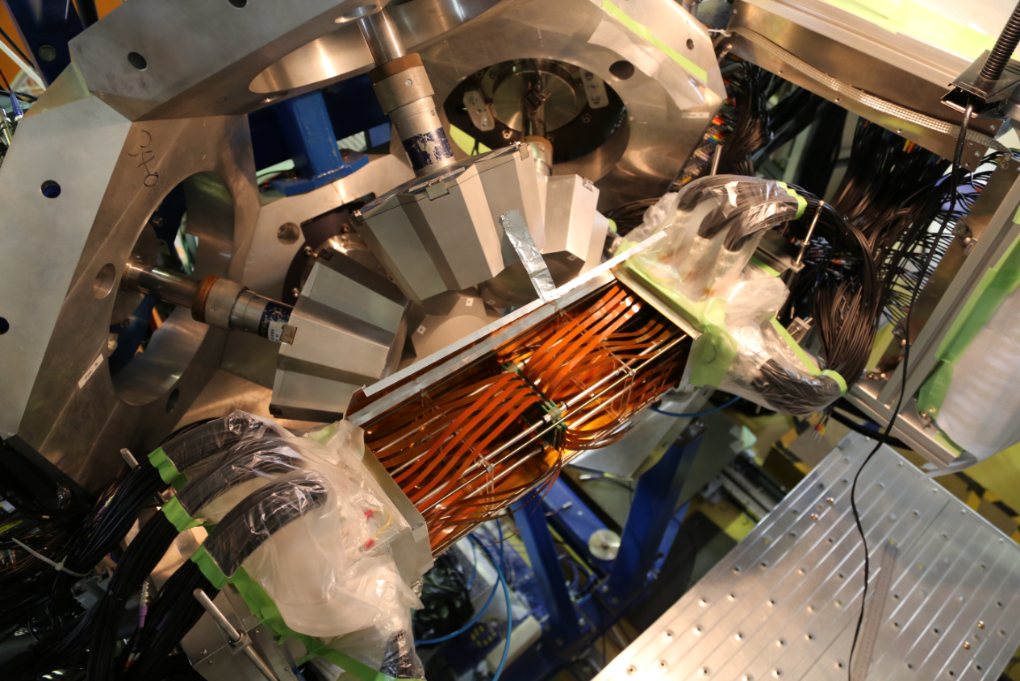
Experimental setup
Beam
β detection array
8 pieces of DSSD with 60×40 pixels (segmented)
The heavy-ion beam implant and stop in DSSD, followed by β decay
The time and positions of the implantation of heavy-ion and β-particle are used to reconstruct decay events
γ detection array
EURICA，12 cluster detectors
Detect γ-rays following β-decay
Addback for higher efficiency
S. Nishimura et al., Prog. Theo. Exp. Phys. 03C006 (2012)

Slide 7
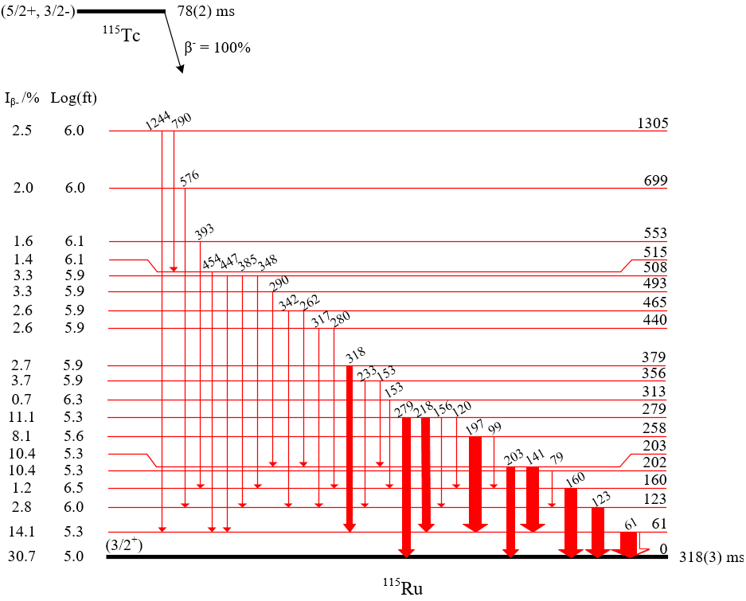
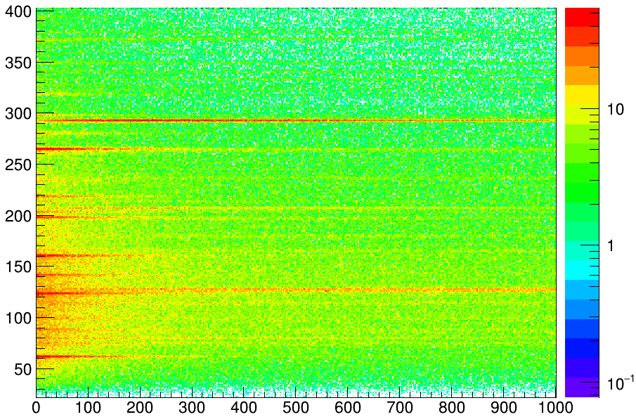
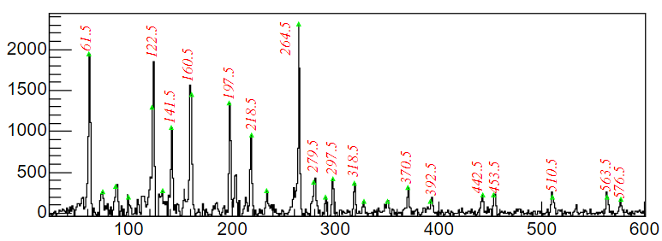
Results of ¹¹⁵Ru
E/keV
E_{γ} - β decaytime correlated spectrum
3*T_{1/2}
3*T_{1/2}
292, ¹¹⁵Rh
127, ¹¹⁵Pd
61, ¹¹⁵Ru
t_{β} - t_{beam} / ms
Counts
Counts
β-γ spectrum
61keV coincident spectrum
E/keV
E/keV

Slide 8
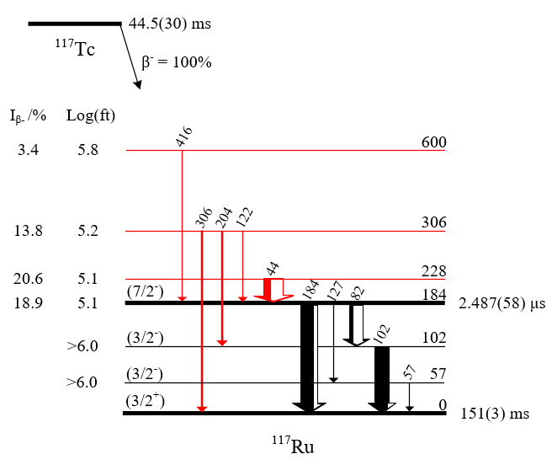
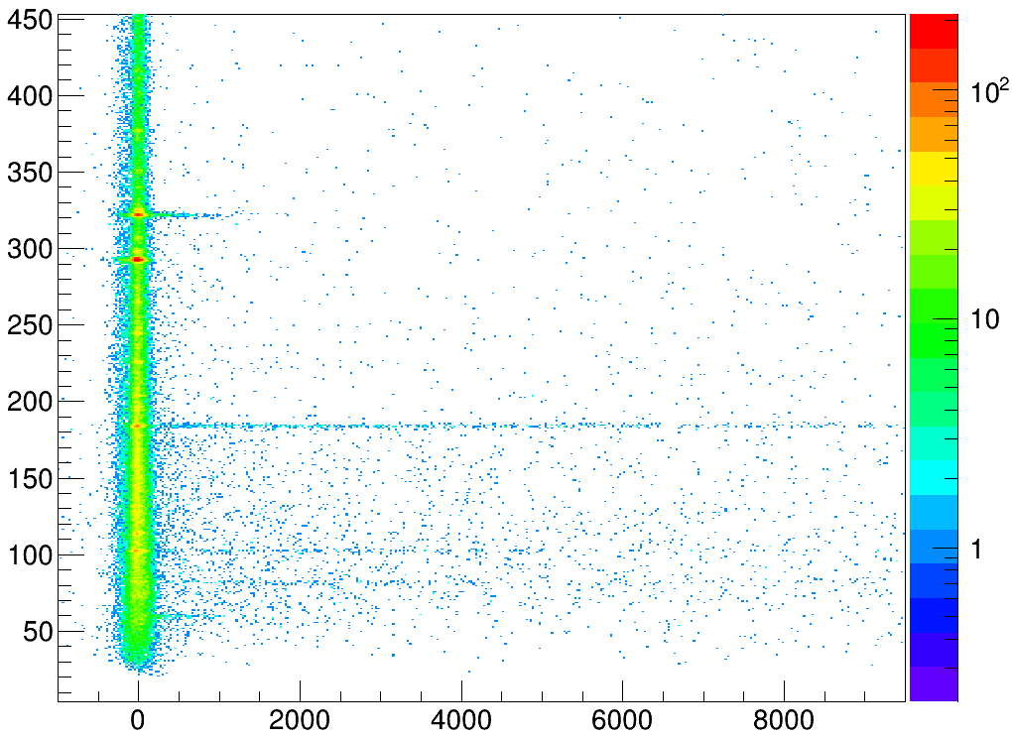
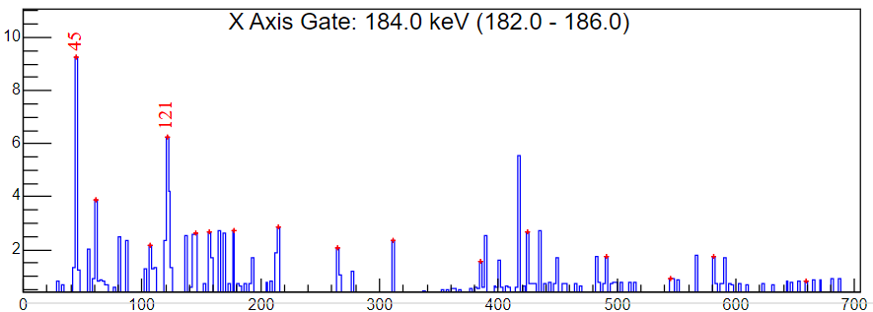
Results of ¹¹⁷Ru
E/keV
184
102
82
184keV delayed coincidence spectrum
416
t_{γ} - t_{β} /ns

Slide 9
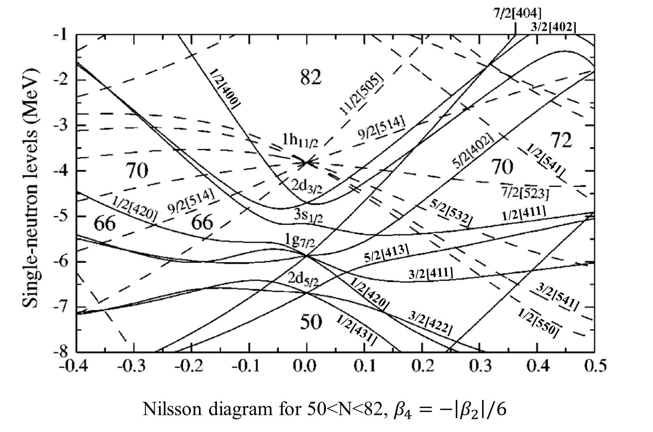
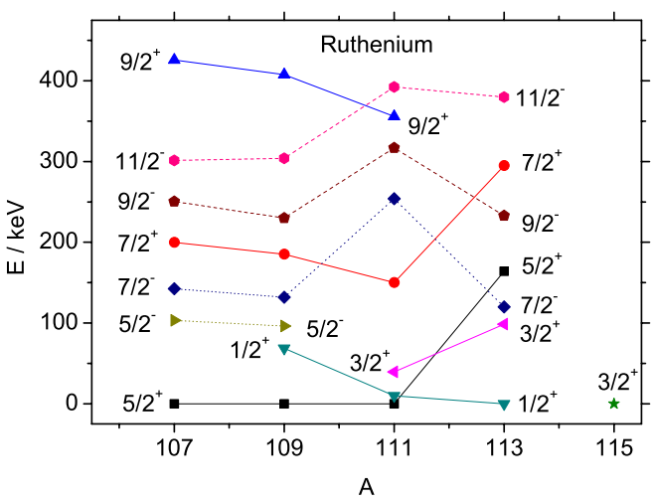
Systematics and Nilsson diagram
¹¹⁵Ru₇₁ & ¹¹⁷Ru₇₃
systematics
72
64
117
β₂
¹⁰⁹Ru₆₅
¹⁰⁹Ru has prolate deformation of β₂ ~ 0.3 (probably with some triaxial degrees of freedom)
No 3/2⁺ orbital in the vicinity of N = 72 Fermi surface on the prolate side
One could find such orbital on the oblate side as the g.s. of ¹¹⁵Ru ¹¹⁷Ru
J. Rissanen et al., Eur. Phys. J. A 47, 97 (2011)
F. R. Xu et al., Phys. Rev. C 65, 021303 (2002)

Slide 10
Transition probability
B(M2, 184keV) = 1.4(3) W.u.
70
7/2- isomer comes from h_{11/2} intruder orbit, with little mixing and (near) sphere shape
B(M2, 184keV) ~ 1 W.u., indicating a small structural difference between g.s. and isomer
This is consistent with the slight oblate deformation of ¹¹⁷Ru g.s.

Slide 11
Summary
The level scheme of ¹¹⁵Ru and ¹¹⁷Ru are established through the spectroscopic study of β-decay.
Based on the analysis of spin and parity and transition probability, the g.s. of ¹¹⁵Ru and ¹¹⁷Ru are assumed to be slightly oblate deformed, which could be the shape transition point of Ru isotopes.
Thank you for listening!

Slide 12
Palladium

