Slide 1
Direct measurement of the ²⁶Si(α, p)²⁹P reaction for the nucleosynthesis in X-ray bursts
Short presentation, 2023/8/31
CNS, D1, Kodai Okawa
Notes:
Thank you for the introduction.
I am Kodai Okawa from CNS, the university of Tokyo.
I am honored to be able to show my research at this workshop.
My research topic is “Direct measurement of the 26Si(a, p) reaction for the nucleosynthesis in X-ray burst”.
Due to the time limitation, I would like to explain only the motivation part, so if you are interested, we can discuss it during the poster session time.

Slide 2
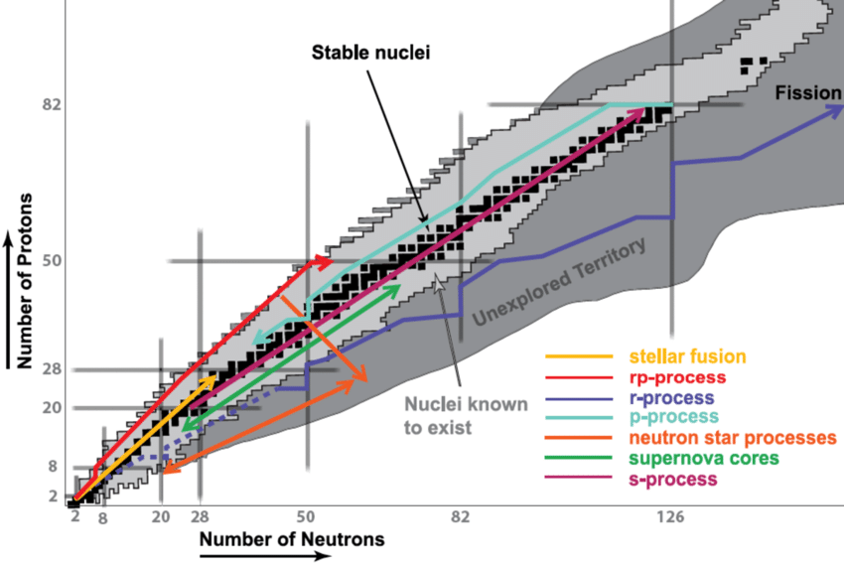
Why is the ²⁶Si(α, p)²⁹P reaction important?
rp-process
Cited from IUPAP Report 41 Introduction
Notes:
First, I would like to explain why the 26Si(a, p) reaction is important.
Here is a famous figure showing various processes of the nucleosynthesis.
I would like to focus on the process that takes place on the proton-rich side.

Slide 3
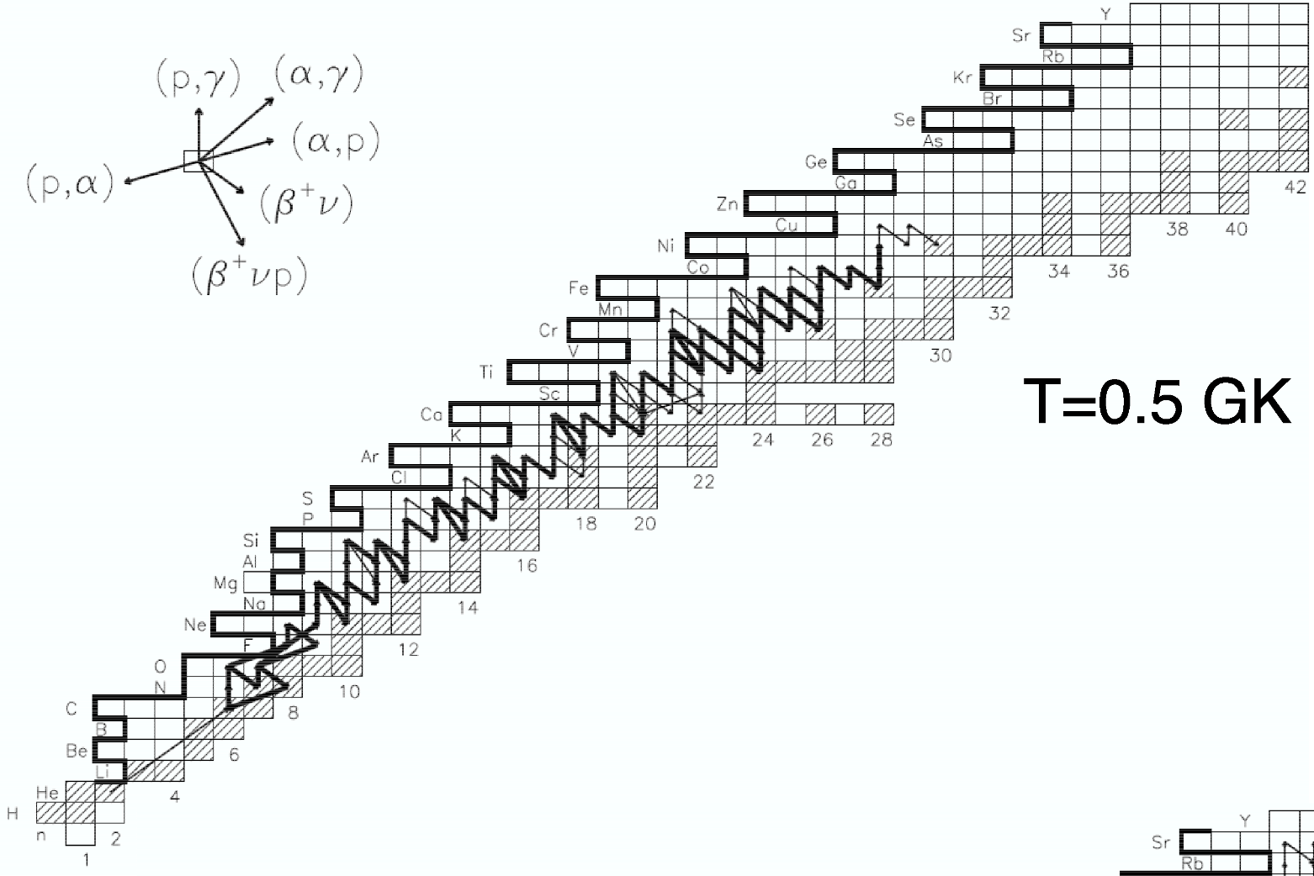
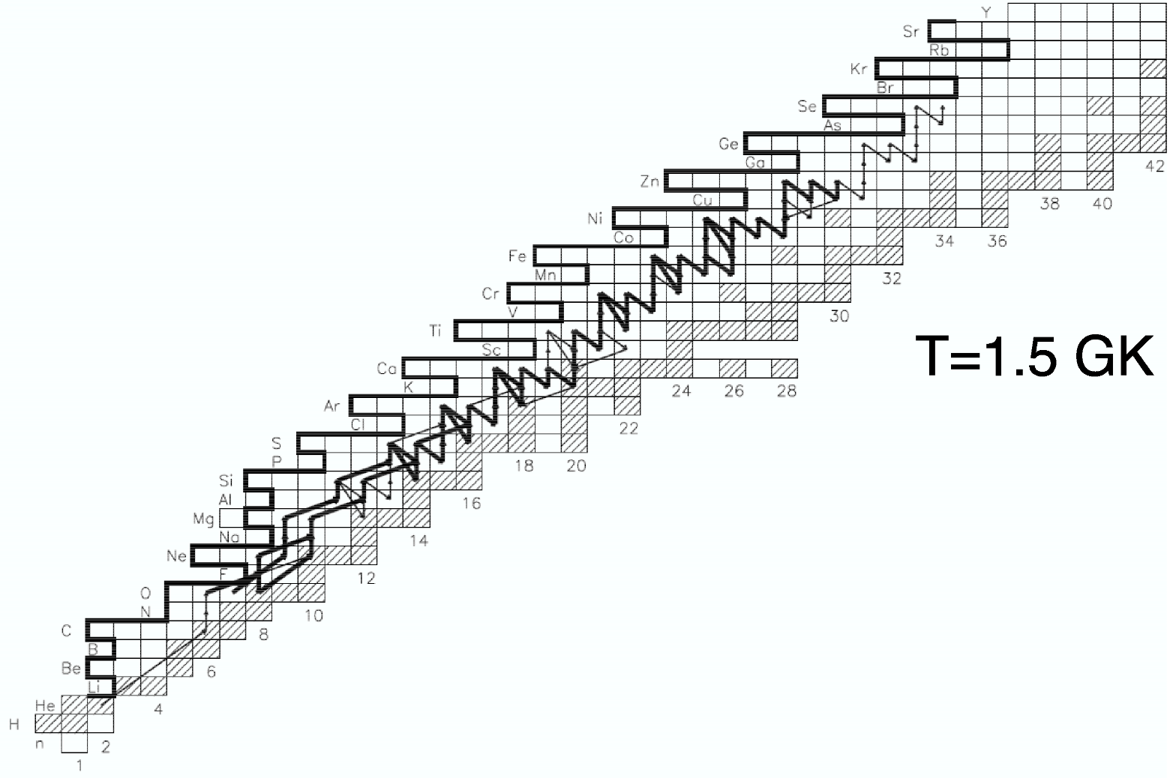
Why is the ²⁶Si(α, p)²⁹P reaction important?
²⁶Si(α, p)²⁹P
(p, γ)
(p, γ)
rp-process
αp-process
(β⁺ν)
(α, p)
From a textbook of “Nuclear Physics of Stars”
Waiting point nuclei in the rp-process: ²²Mg, ²⁶Si, ³⁰S, ³⁴Ar and so on.
  Long β+ decay half-life and small Q-value of the (p, γ) reaction
=> At the high temperature, the (α, p) reactions bypass these waiting points and are considered to accelerate the reaction flow.
Notes:
The process is considered to proceed under high temperature environment..
The left figure shows a typical nuclear reaction path at T = 0.5 GK.
Many reaction in this network proceed through the sequence of the (p,gamma) reaction and beta+ decay, called rp-process.
In this network, there are important nuclei that are waiting points due to their long beta+ decay half-life and small Q-value of (p, gamma) reaction, such as 22Mg, 26Si, 30S and 34Ar.
As the temperature increases, as shown in this right figure, the (a,p) reaction becomes competitive.
Then, these (a,p) reactions bypass these waiting points and are considered to accelerate the reaction flow.
This sequence of reactions involving (a, p) reaction is called ap-process.
Here, the 26Si(a,p) reaction is one of the reactions in this ap-process.

Slide 4
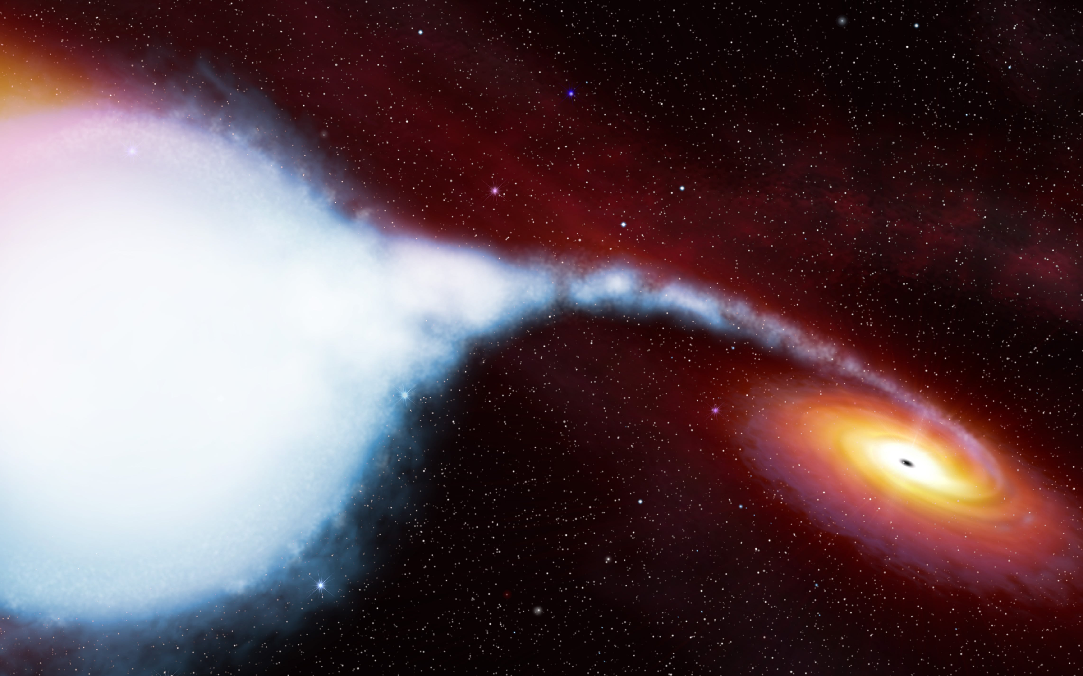
Why is the ²⁶Si(α, p)²⁹P reaction important?
X-ray bursts
  Typical value: temperature: T ~ 1 GK, density: 1.0 × 10⁶ g/cm³
Talked by Dohi-san
Notes:
One of the sites where such a nucleosynthesis occurs is X-ray bursts
Yesterday, we have a nice lecture about X-ray bursts from Dohi-san, and also today, so I will move on to the next.

Slide 5
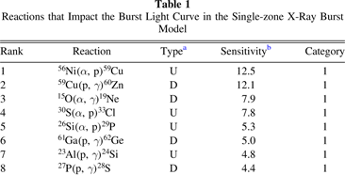
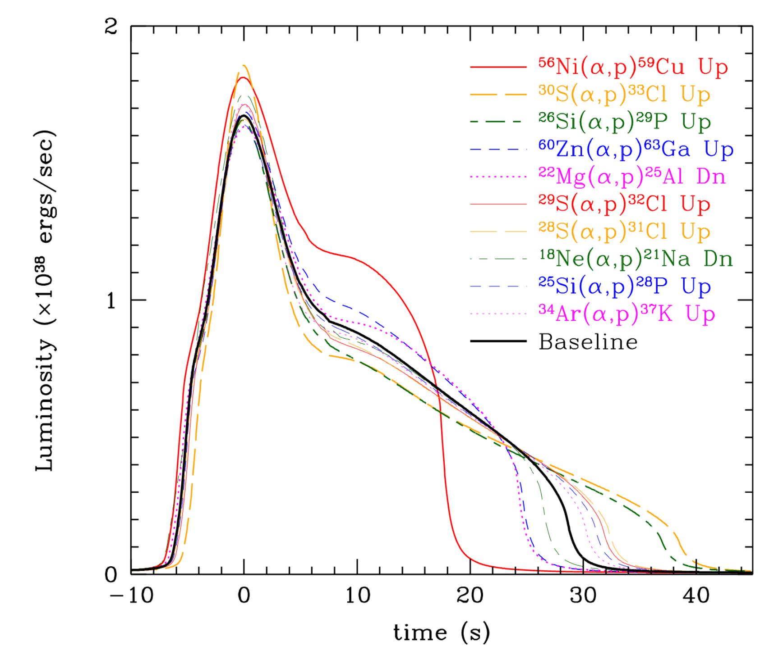
Why is the ²⁶Si(α, p)²⁹P reaction important?
A comprehensive study of the nuclear reactions that affect the light curve of X-ray bursts was done by Cyburt et al.
  List nuclear reactions in order of sensitivity
  => The ²⁶Si(α, p)²⁹P reaction was classified in the most sensitive category
Accurate experimental data on this reaction would lead to a better understanding of nucleosynthesis in X-ray bursts.
R.H. Cyburt et al., Astrophys. J. 830, 55 (2016).
Talked by Jayatissa-san
Notes:
Actually, about this slide, there was also nice lecture from Javatissa-san.
Anyway, one of the observables of this X-ray burst is the light curve.
This figure is actually from a simulation, but the light curve is the time variation of the luminosity of the X-ray burst.
Then, a comprehensive study of the nuclear reactions that affect the light curve of the X-ray burst was done by Cyburt et al. (you know this is very famous paper.)
And it showed that the 26Si(a,p) reaction has a high sensitivity to the light curve, the reaction located at rank 5 indeed.
The left figure shows how much the simulation result of the light curve changes when the rate of one nuclear reaction is varied.
The 26Si(a,p) case is shown in the green line.

Slide 6
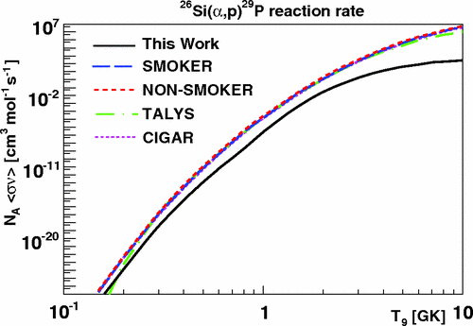
Previous research on the ²⁶Si(α, p)²⁹P reaction rate
Hauser-Feshbach statistical model
Expected energy range in this experiment
10.5 < E_{X} < 16.0
16.0
experiment
Gamow window
Energy range measured in previous study (over α-threshold energy)
E_{X} < 12
12.0392
3 GK
Different by about two orders of magnitude
2 GK
1 GK
0⁺
9.343
9.3914
²⁶Si + α
S. Almaraz-Calderon et al., Phys. Rev. C 86, 065805, (2012)
2.423
3/2⁺
The reaction rate was evaluated “indirectly” by a ³⁰S level structure study using ²⁸Si(³He, n) and ³²S(p, t) reactions.
  Identified resonant states for E_{x} < 12 MeV
  No spin assignment for higher energy level (> E_{α} = 9.4 MeV)
=> Our motivation is to measure the ²⁶Si(α, p)²⁹P reaction “directly” in the high energy region
1.954
5/2⁺
1.383
3/2⁺
0.0
1/2⁺
4.399
²⁹P + p
0⁺
0.0
³⁰S
Notes:
However, the reaction rate of this reaction has been studied only one time at limited energy range through a 30S level structure study using these two reactions.
In this study, resonance states with excitation energies only up to 12 MeV were identified, and there are no spin assignment at energy levels above the α threshold, which is important for the 26Si(a,p) reaction.
Therefore, the evaluated reaction rates have a large discrepancy with statistical models.
So, our goal of this research is to measure the 26Si(a, p) reaction directly in the high energy region and to determine the reaction cross section.

Slide 7
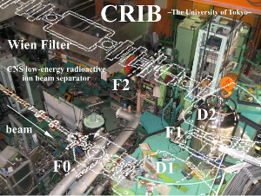
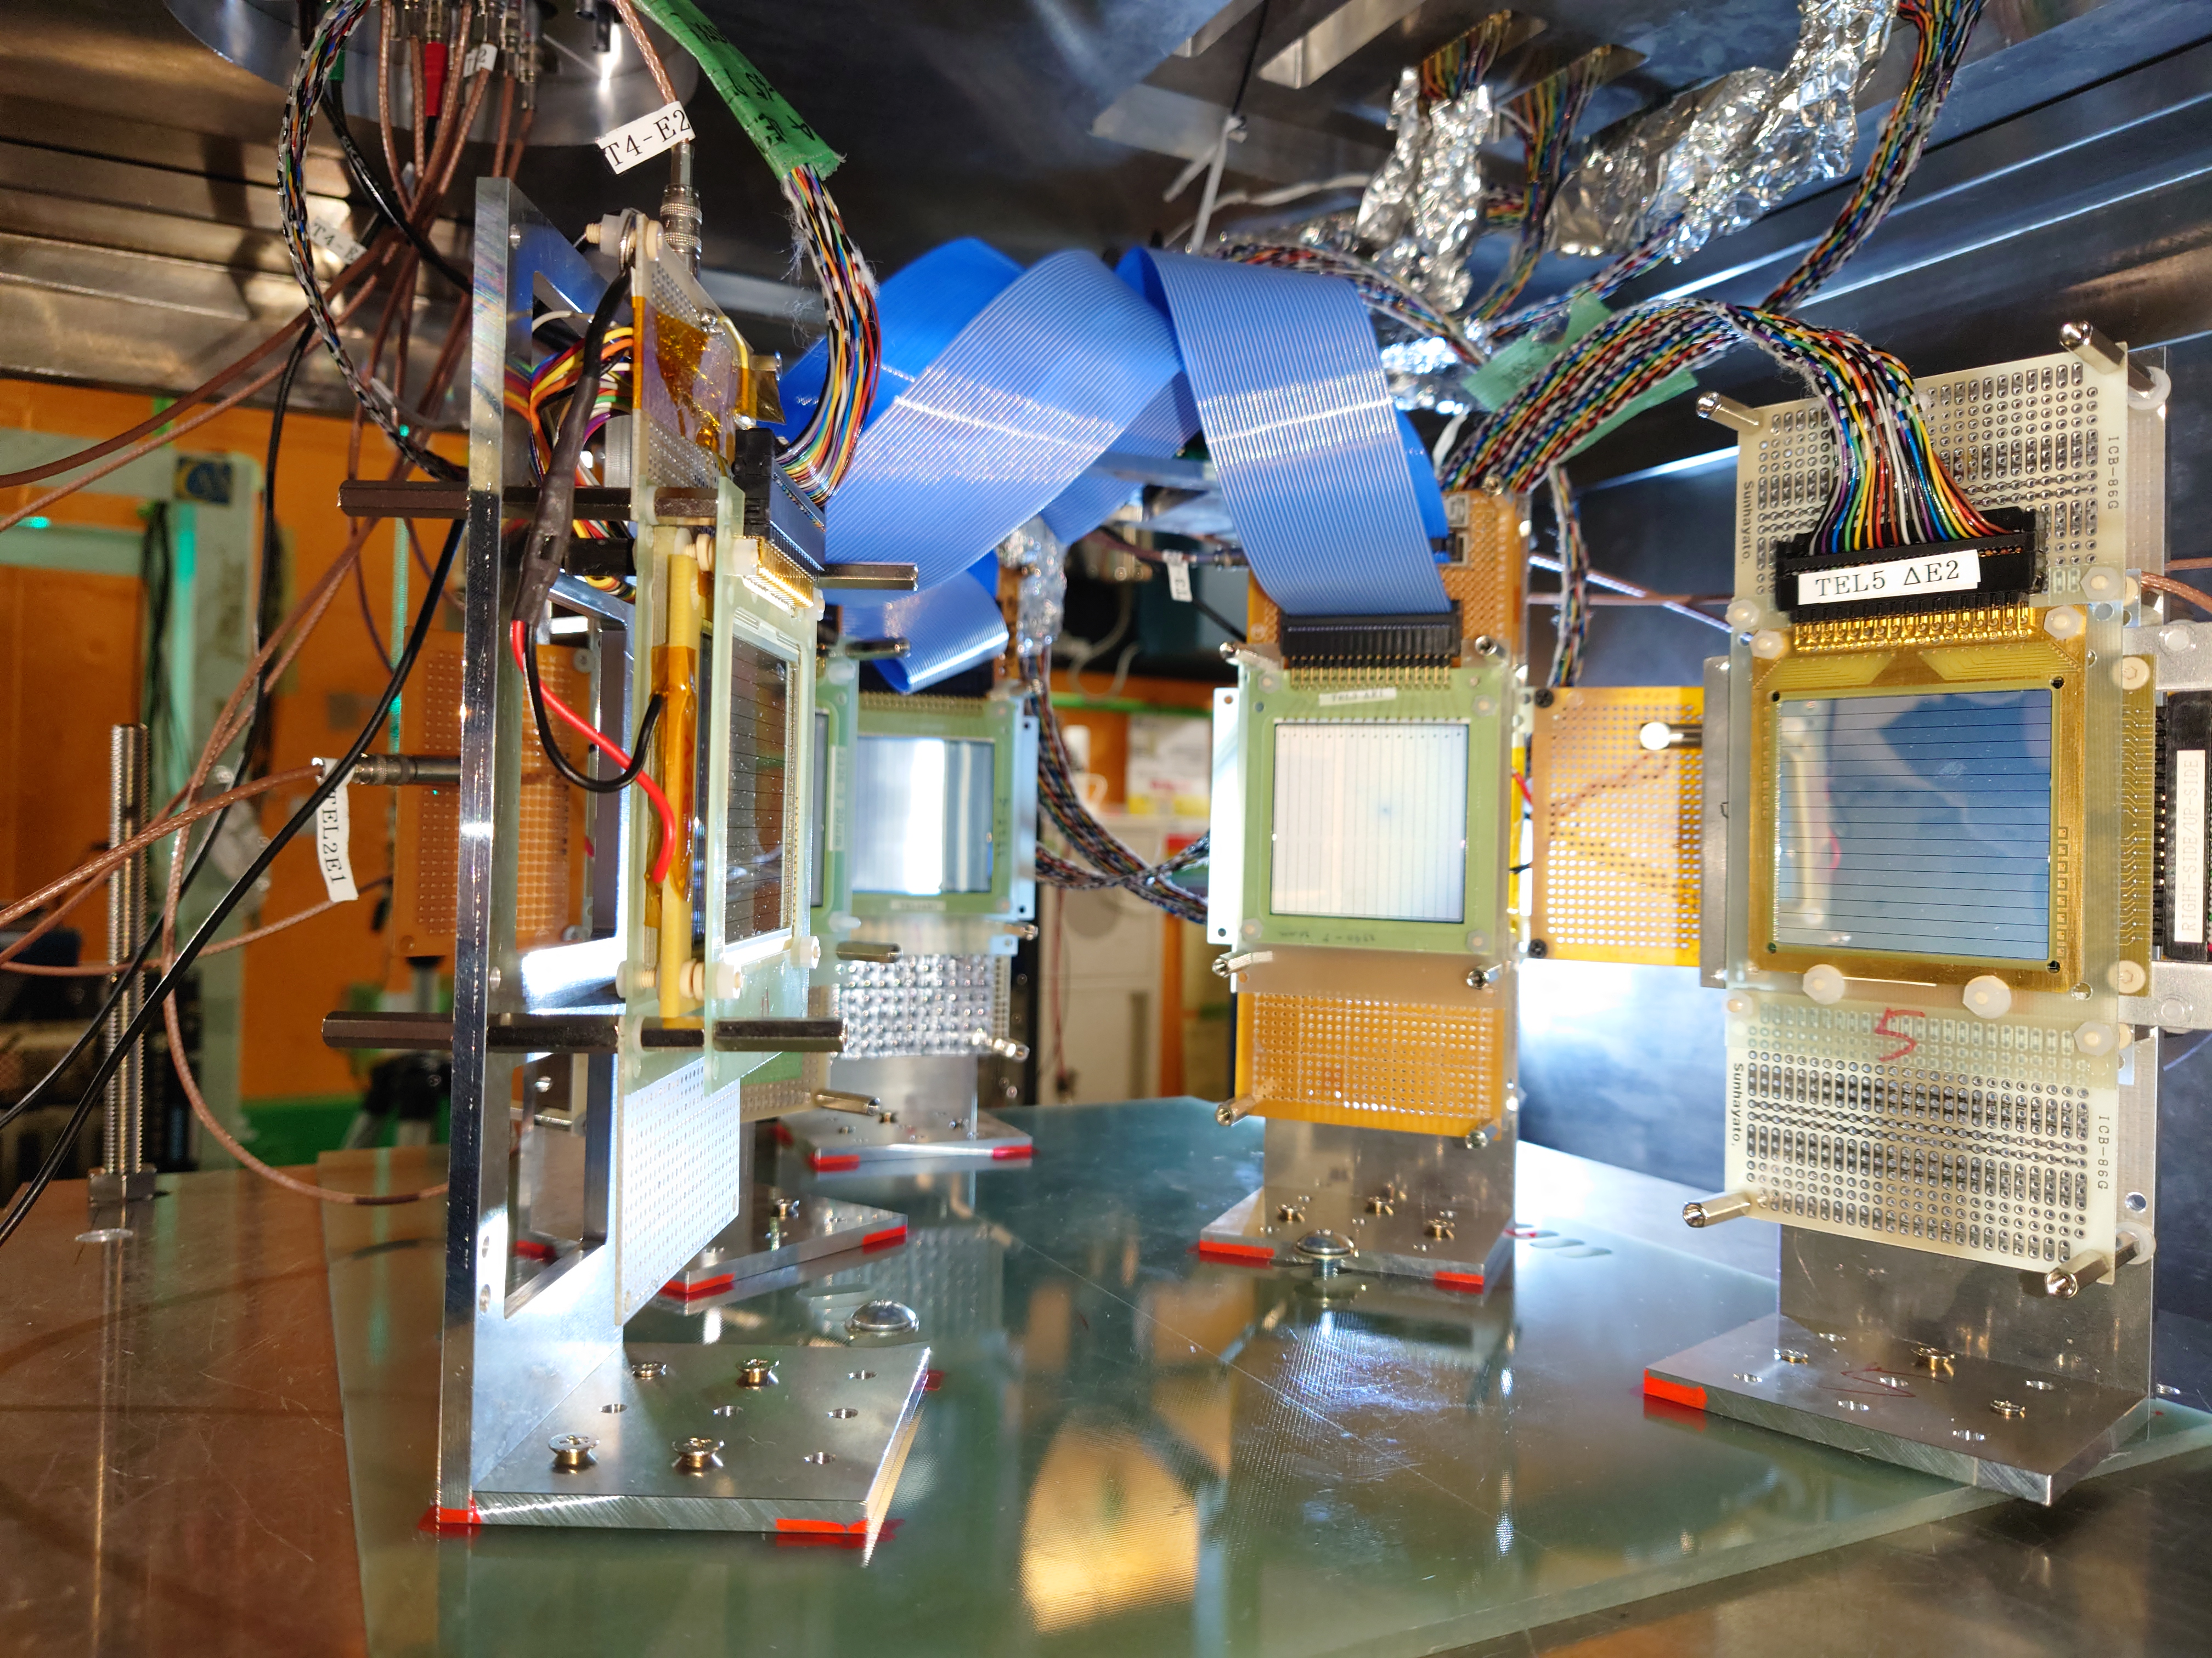

Setup for the measurement
($∼$ 250 Torr)
³He
7.5 MeV/u
3000 enA
16.86 MHz
²⁴Mg
CRIB (CNS RadioIsotope Beam separator)
²⁶Si
⁴He
Si detectors
The ³He(²⁴Mg, ²⁶Si)n reaction produced ²⁶Si ions
Reaction particle detected by Si detectors
Notes:
I will skip the details, but the experiment was performed at CRIB in RIKEN RIBF.

Slide 8
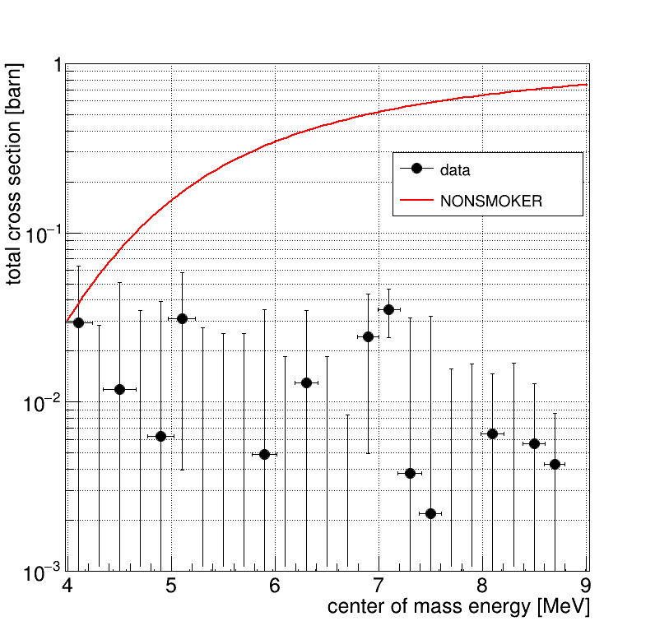
Preliminary cross section
Because of the large error due to low statistics and many background events, it is not possible to conclude that a significant ²⁶Si(α, p)²⁹P reaction could be detected.
However, the result shows that the experimental cross section was about one order of magnitude lower than the statistical model value in the high energy region.
NON-SMOKER
(outside of the window)
Notes:
Also ,I will skip detail, the experimental results are an order of magnitude smaller than the values of the statistical model, although the errors are quite large due to the data quality.
That's all
So if you are interested, we can discuss this in the poster presentation time.
Thank you for your attention.

