Slide 1

Proton charge radius measurement
CNS International Summer School 2020
Legris Clement
Tohoku University, ELPH (Research Center for Electron Photon Science)

Slide 2
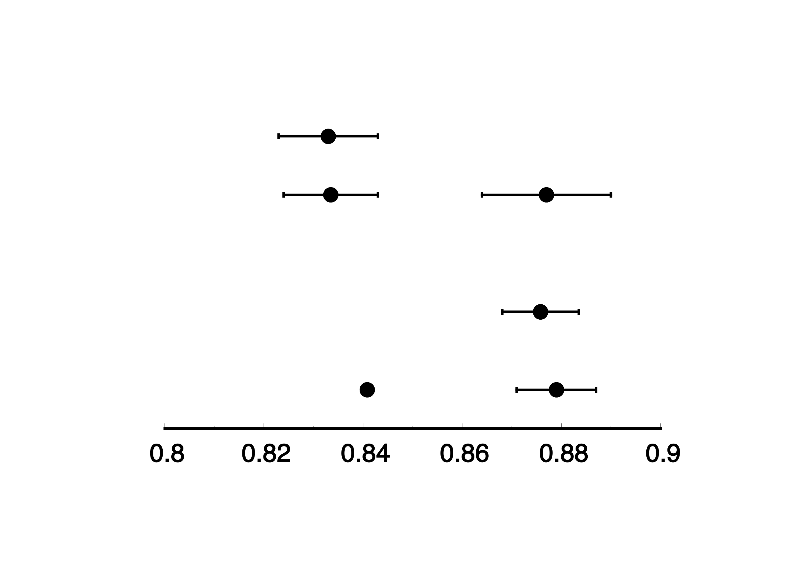
Proton charge radius puzzle
JLAB
(2019)
Electron
scattering
(1950~)
Trento (2019)
Paris (2018)
Hydrogen spectroscopy
(1990~)
Garching (2017)
Muonic hydrogen spectroscopy
（2010）
(fm)
Notes:
Image from Suda-san’s presentation for subvention p4
Add fm

Slide 3
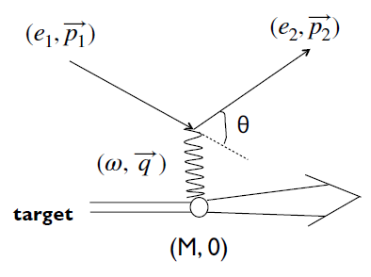
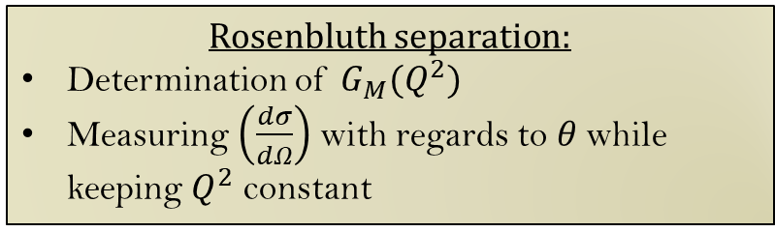
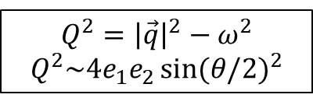
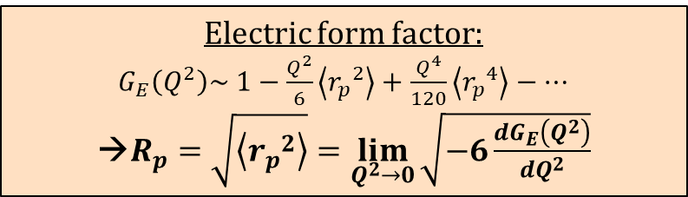
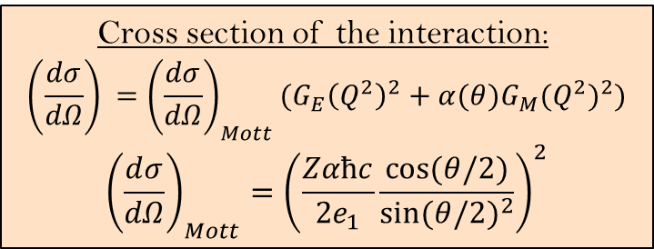
Determination of the proton charge radius with electron scattering
Cross section of the interaction:
$$\left(\frac{dσ}{dΩ}\right) ={\left(\frac{dσ}{dΩ}\right)}_{Mott}({G_{E}\left(Q^{2}\right)}^{2}+α(θ){G_{M}(Q^{2})}^{2})$$
$${\left(\frac{dσ}{dΩ}\right)}_{Mott}={\left(\frac{Zαħc}{2e_{1}}\frac{\cos{(θ/2)}}{{\sin{(θ/2)}}^{2}}\right)}^{2}$$
Electric form factor:
$G_{E}\left(Q^{2}\right)\sim 1−\frac{Q^{2}}{6}\left\langle {r_{p}}^{2}\right\rangle +\frac{Q^{4}}{120}\left\langle {r_{p}}^{4}\right\rangle −…$
→$R_{p}=\sqrt{\left\langle {r_{p}}^{2}\right\rangle }=\lim_{Q^{2}→0}{\sqrt{−6\frac{dG_{E}\left(Q^{2}\right)}{dQ^{2}}}}$
$$Q^{2}={\left|\vec{q}\right|}^{2}−ω^{2}$$
$$Q^{2}\sim 4e_{1}e_{2}{\sin{(θ/2)}}^{2}$$
Rosenbluth separation:
Determination of $G_{M}(Q^{2})$
Measuring $\left(\frac{dσ}{dΩ}\right)$ with regards to $θ$ while keeping $Q^{2}$ constant
Electron scattering interaction
T. Suda, CNS 2018, ELPH, Tohoku University
Notes:
Image1 from Suda-san’s CNS lecture 1 p8
CS image from Suda-san’s CNS lecture 1 p24

Slide 4
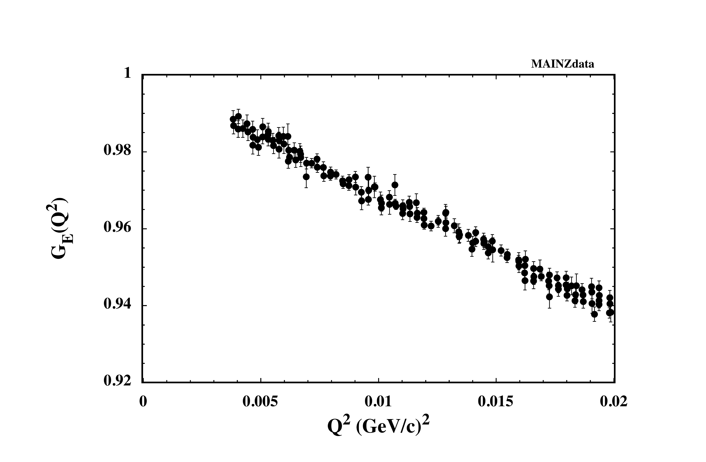

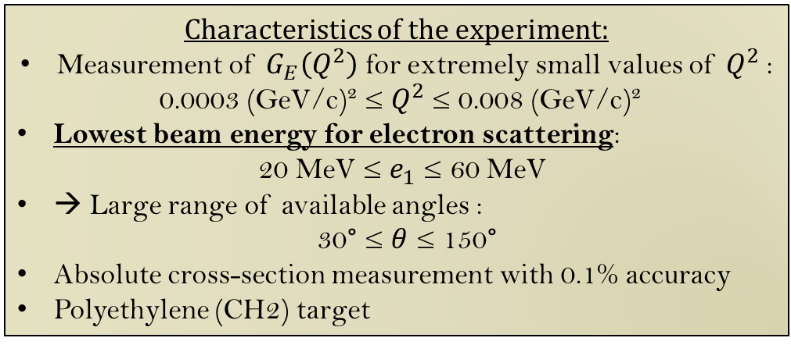

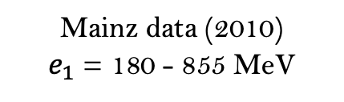
Ultra Low Q² (ULQ2) experiment
$$G_{E}\left(Q^{2}\right)$$
Characteristics of the experiment:
Measurement of $G_{E}\left(Q^{2}\right)$ for extremely small values of $Q^{2}$:
0.0003 (GeV/c)² ≤ $Q^{2}$≤ 0.008 (GeV/c)²
Lowest beam energy for electron scattering:
20 MeV ≤ $e_{1}$ ≤ 60 MeV
→ Large range of available angles :
30° ≤ $θ$ ≤ 150°
Absolute cross-section measurement with 0.1% accuracy
Polyethylene (CH2) target
$$\sim 2\%$$
ULQ2 exp.
Mainz data (2010)
$e_{1}$ = 180 - 855 MeV
Momentum transfer range during the experiment
Y. Honda, ELPH, Tohoku University

Slide 5
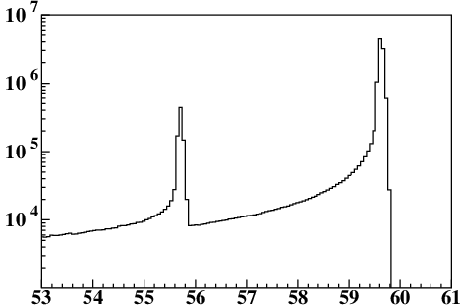

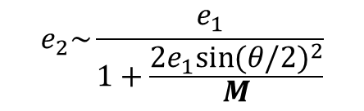
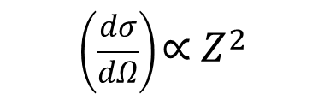

Absolute cross-section measurement
$E_{e}=60 MeV$
$θ=100°$
$$\left(\frac{dσ}{dΩ}\right)\text{∝} Z^{2}$$
Measurement of cross-section of e-X scattering:
$${\left(\frac{dσ}{dΩ}\right)}_{e−X}=\frac{N_{e−X}}{N_{e }{ N}_{X }∆Ω}$$
→ ${\left(\frac{dσ}{dΩ}\right)}_{e−H}=\frac{N_{e−H}/N_{e−C}}{N_{H}/N_{C}}{\left(\frac{dσ}{dΩ}\right)}_{e−C}$
Event number
Events
e-H e-C
Beam
dose
Target
number (cm¯²)
Detector
solid angle
Well
known
$$e_{2}\sim \frac{e_{1}}{1+\frac{{{2e}_{1}sin{(θ/2)}}^{2}}{M}}$$
Energy (MeV)
Target mass
Ratio of H and C
Scattered electron energy of a 60-MeV energy beam on a CH₂ target
Y. Honda, ELPH, Tohoku University

Slide 6
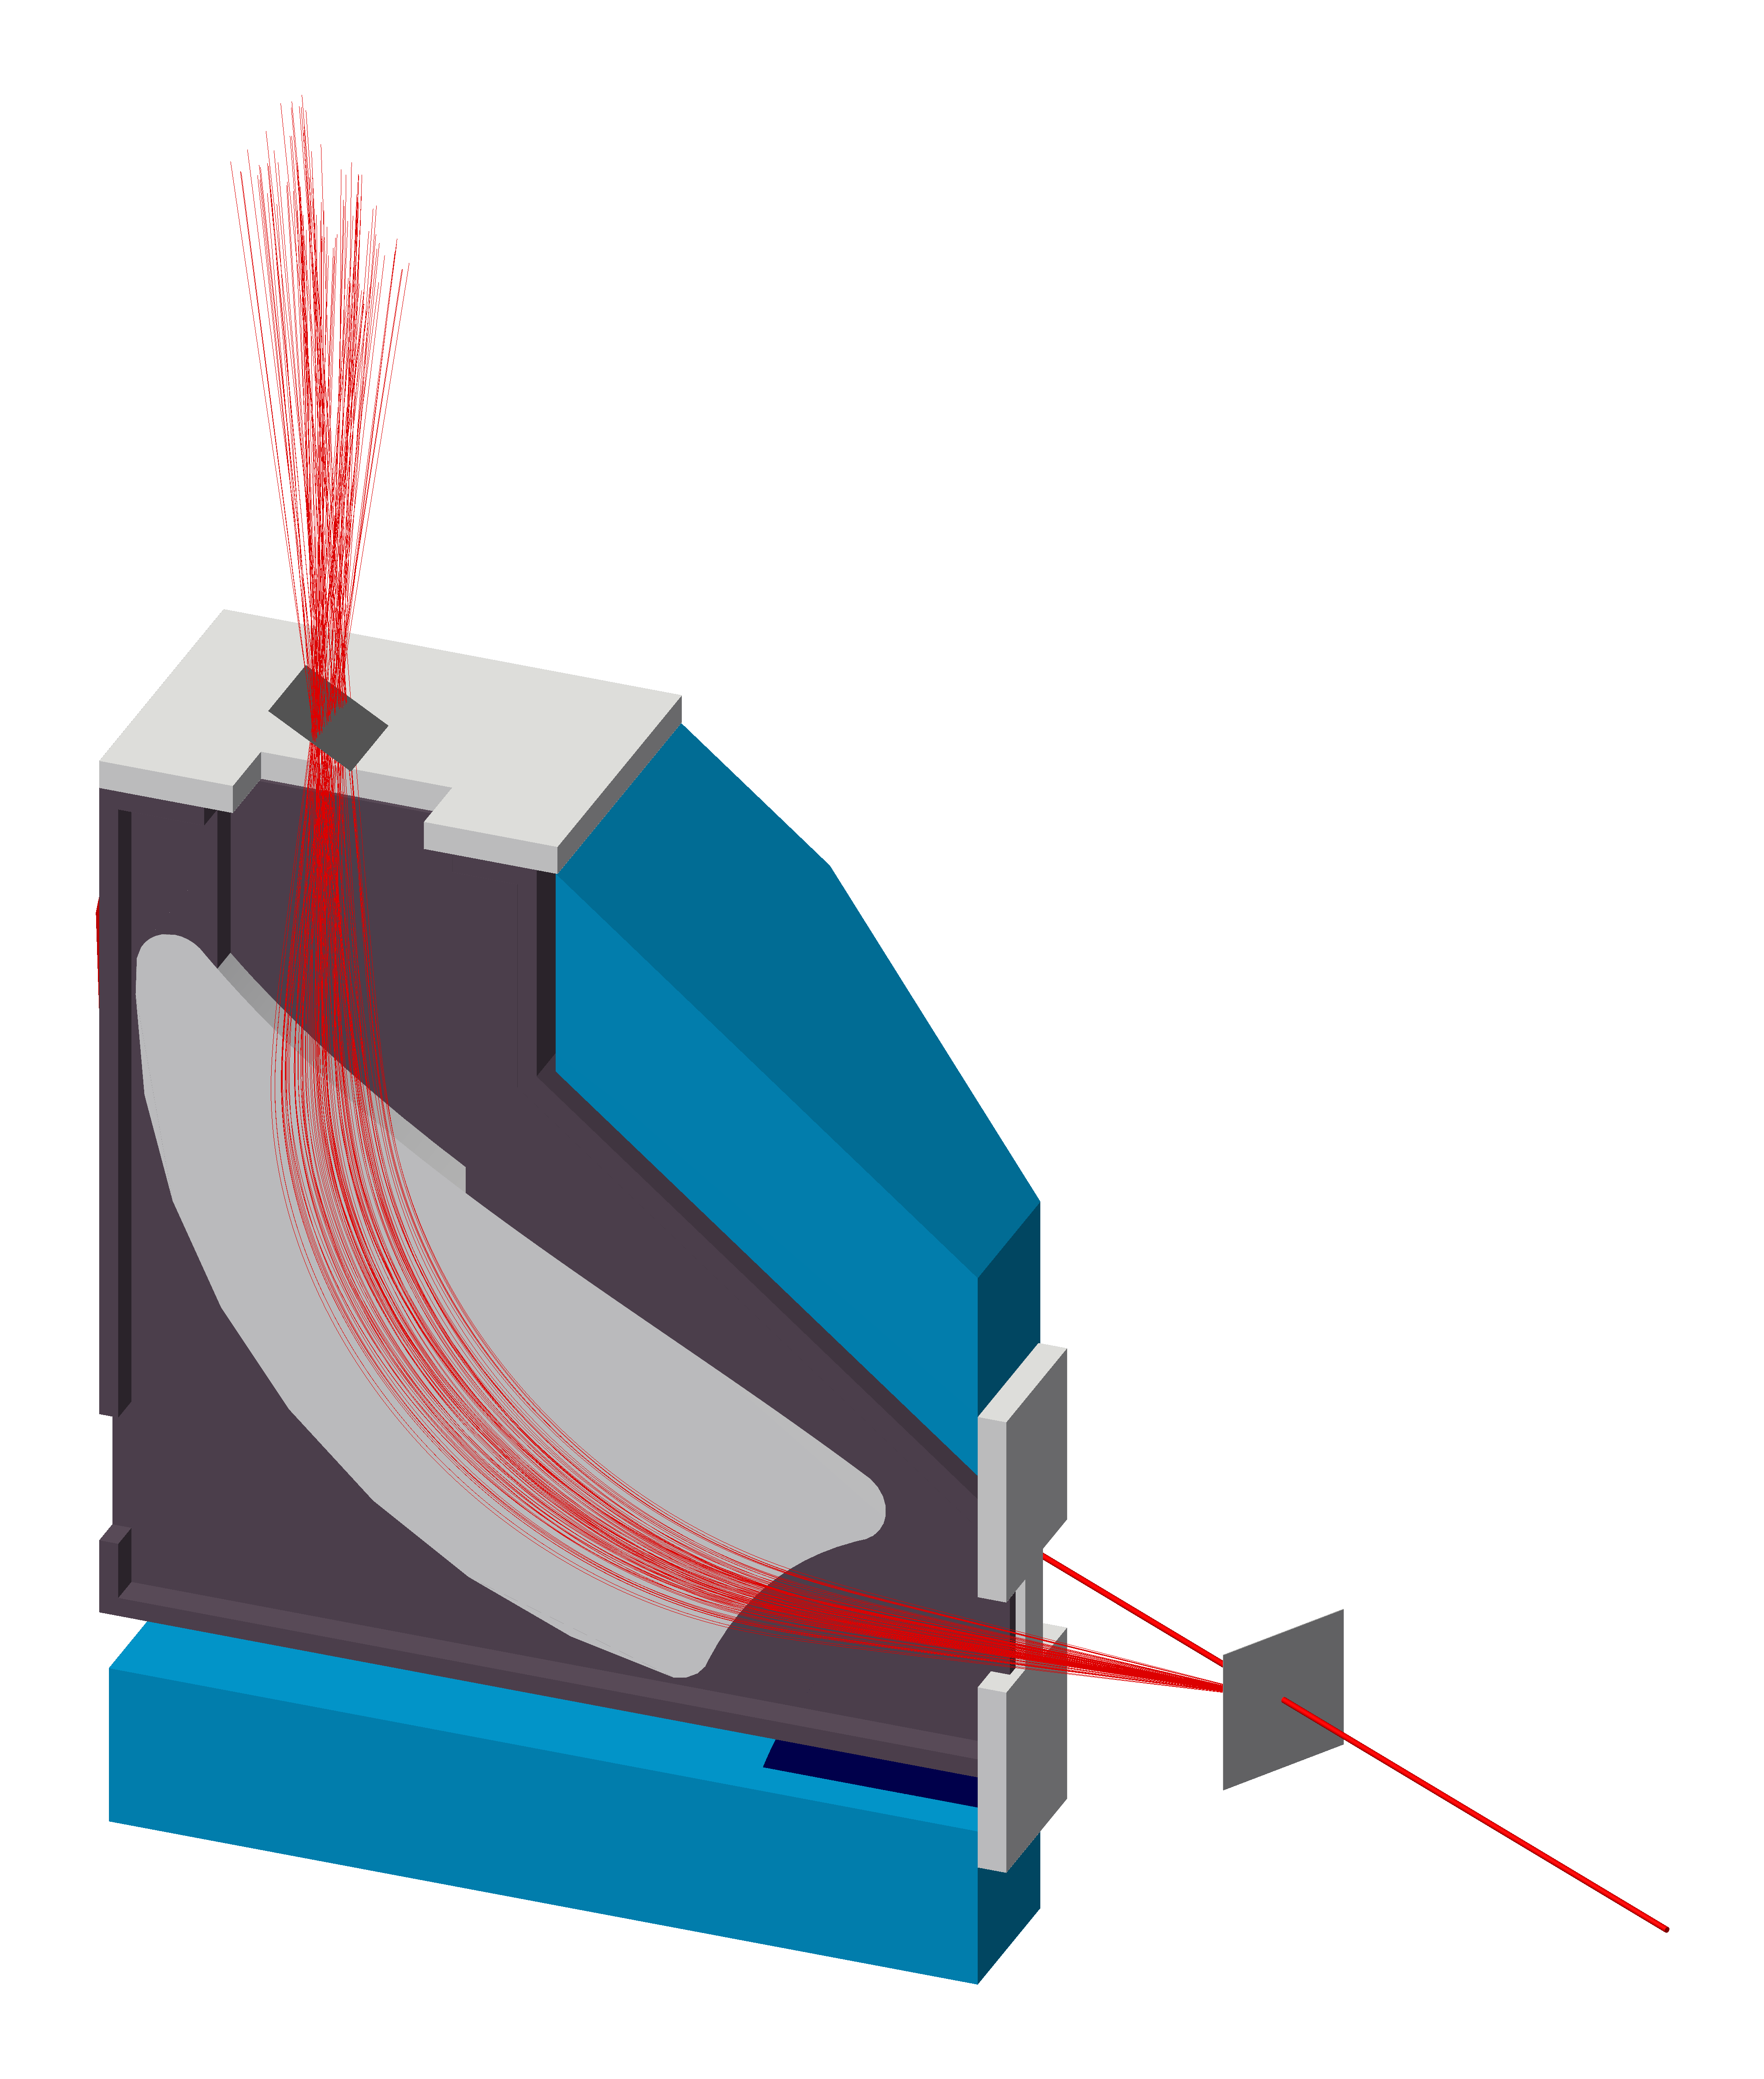
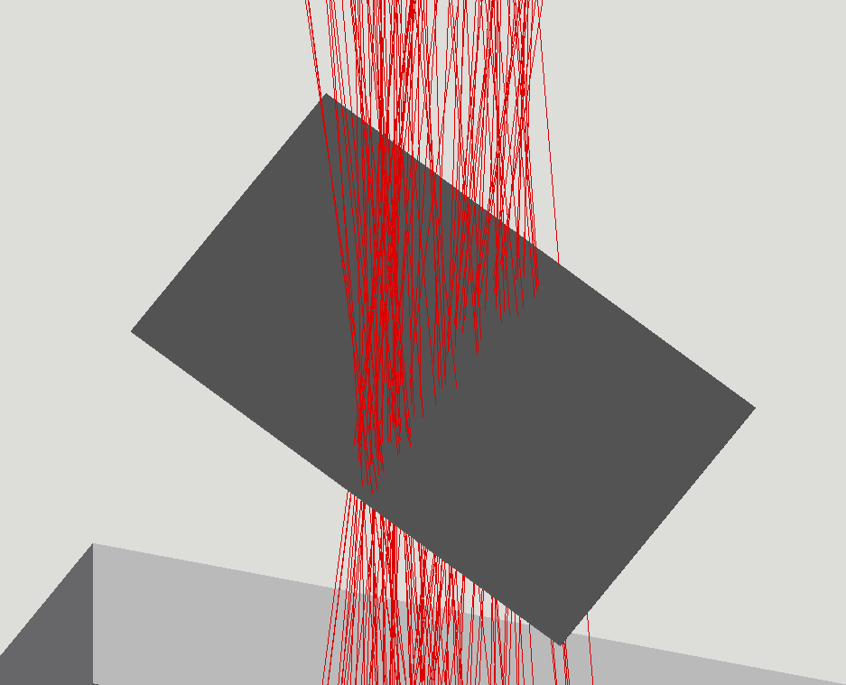
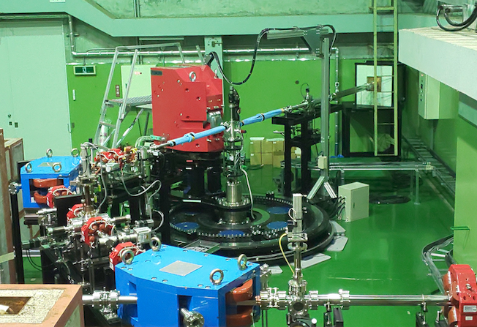



Spectrometer and detectors
$$x→p_{2}$$
$$y →Δθ$$
$$θ$$
Vacuum chamber
& target
e⁻ beam
Spectrometer and detectors
Y. Honda, ELPH, Tohoku University

Slide 7
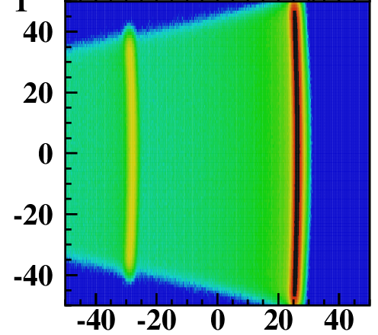


Spectrometer and detectors
Momentum
$$x→p_{2}$$
~5%
~5%
Spectrometer and detectors:
Collimator : -3° ≤ $Δθ$ ≤ +3°
Center of momentum $P_{0}:$
→ Imposed by the magnetic field inside the spectrometer
Relation between position and momentum:
$x=\left(x | δ\right)\frac{P−P_{0}}{P_{0}}$, with $\left(x | δ\right)$ = (855.0+/-0.5) mm
Ratio of momentum $R=\frac{P_{C}}{P_{H}}=\frac{1+x_{c}/(x|δ)}{1+x_{H}/(x|δ)}$
→ Allows to calculate precisely the initial energy of the beam
H
C
y [mm]
Scattering angle ($Δθ$)
$$y →Δθ$$
Momentum dispersion (calculated with Geant 4)
Vacuum chamber
& target
x [mm]
e⁻ beam
Spectrometer and detectors
Y. Honda, ELPH, Tohoku University
Scattered electron energy on a CH₂ target
Y. Honda, ELPH, Tohoku University

Slide 8


Spectrometer and detectors
Momentum
$$x→p_{2}$$
Spectrometer and detectors:
2 SSD detectors of ~10cm x 10cm: 512 strips of 190 μm
Momentum resolution (calculated with Geant 4):
$\frac{∆P}{P_{0}}$ ~ 6 × ${10}^{−4}$
Smallest distance between two distinguishables peaks :
  $∆x =\left(x | δ\right)\frac{∆P}{P_{0}}$ ~ 0.54 mm
→ Sufficient precision
$∆x$
H
C
y [mm]
Scattering angle ($Δθ$)
$$y →Δθ$$
$$θ$$
Vacuum chamber
& target
x [mm]
e⁻ beam
Spectrometer and detectors
Y. Honda, ELPH, Tohoku University
Scattered electron energy on a CH₂ target
Y. Honda, ELPH, Tohoku University

Slide 9
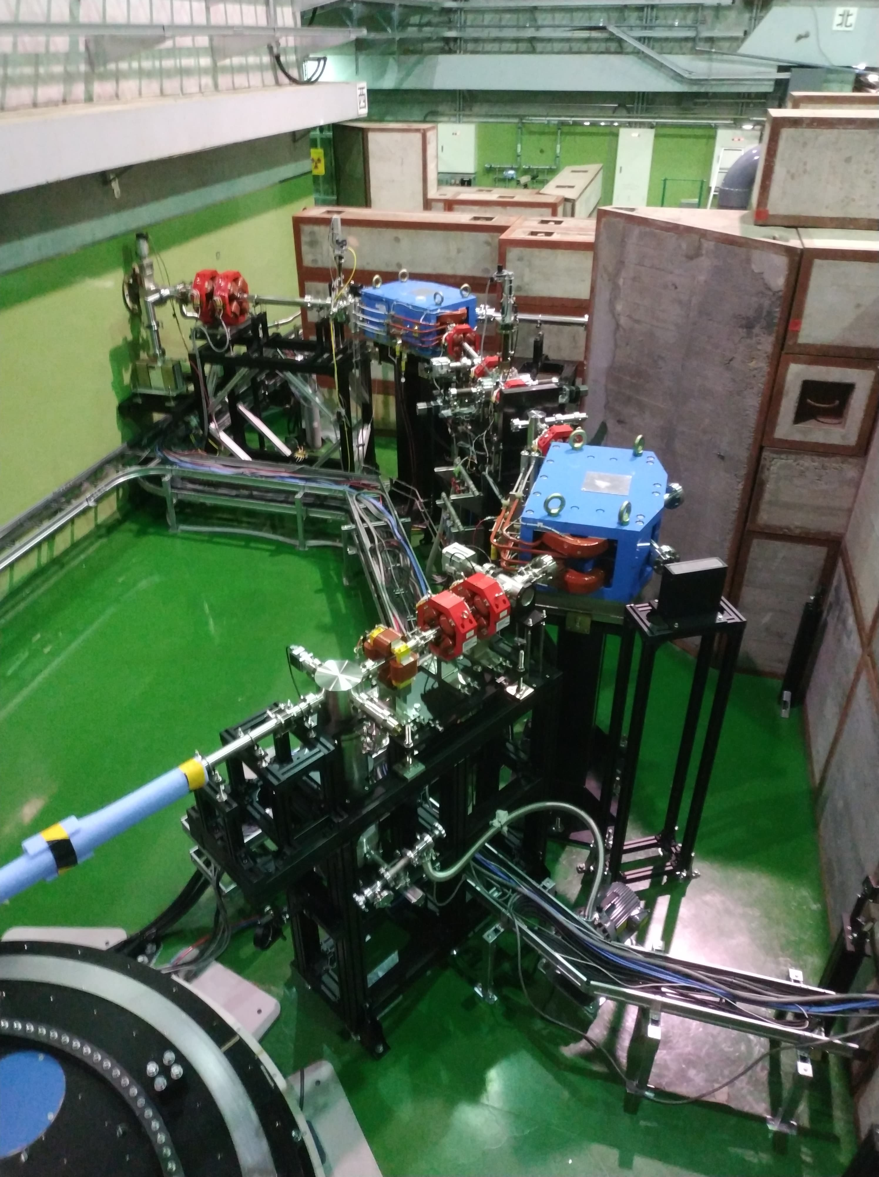
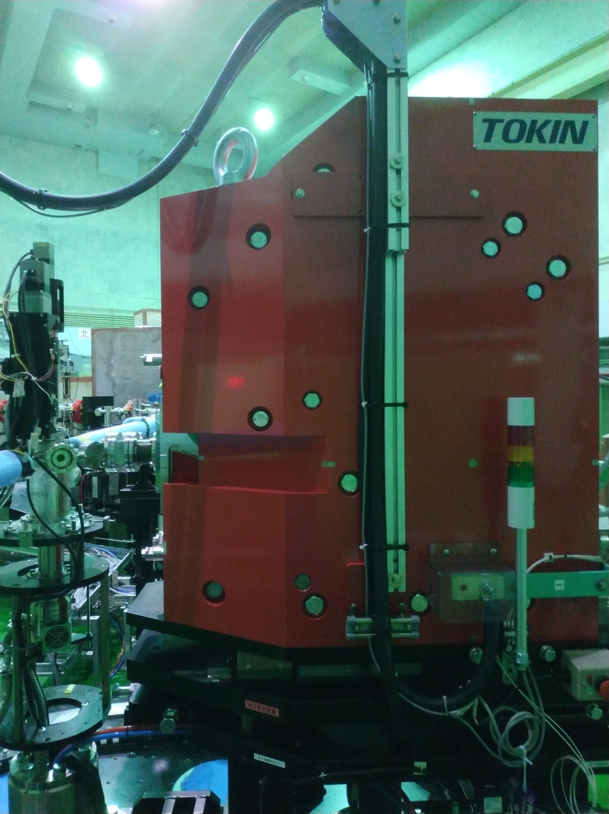
Schedule
First test planned for September 2020 → beamline study and commissioning of the spectrometer in 2020
First measurement of the proton charge radius in end of 2021
Precise measurement of the proton charge radius in mid. 2022

Slide 10
Summary
Proton charge radius measurement by electron scattering on a CH2 target
Extremely low momentum-transfer using the lowest beam energy for electron scattering
Spectrometer and detectors allowing us to measure with a good accuracy the elastic cross-section
Precise measurement of the proton charge radius scheduled in mid. 2022
Notes:
Image1 from Suda-san’s CNS lecture 1 p8
CS image from Suda-san’s CNS lecture 1 p24

Slide 11
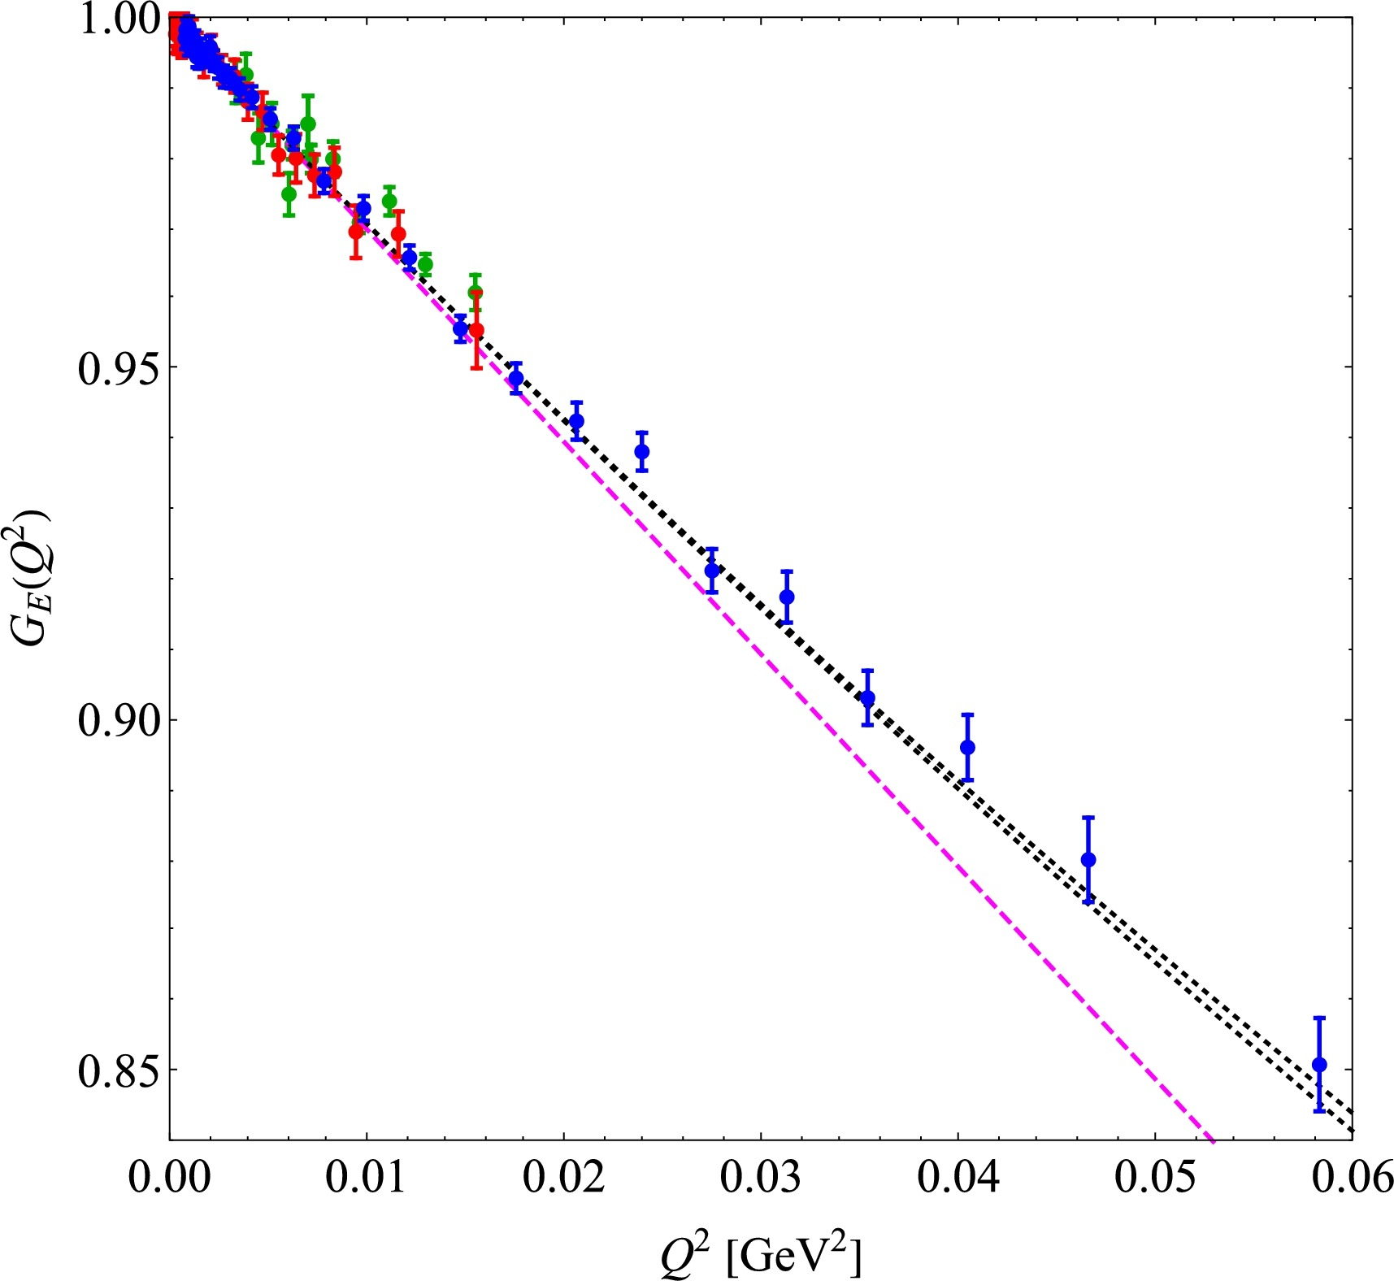
Backup
Data from Jlab (1.1 GeV & 2.2 GeV)
Data from Mainz
1st order extrapolation with model using muonic hydrogen radius measurement
Previous measurements of the proton charge radius
Marko Horbatsch, Properties of the Sachs electric form factor of the proton on the basis of recent e − p scattering experiments and hydrogen spectroscopy
Notes:
Image1 from Suda-san’s CNS lecture 1 p8
CS image from Suda-san’s CNS lecture 1 p24

